Slide 1
Caballo Blanco (Micah True)
One of craziest stories I’ve ever read was that of the cult icon, the phantom of the desert, a shadowy figure and running legend, Caballo Blanco – or his allias – Micah True
He survived for years, if not decades, running through the brutal Copper Canyon; Sierra Madre mountains of Northern Mexico
Where distances from hut to hut could easy range from 30-60 miles
as the story goes, he would pop in somewhere, stay for a meal or a night, then vanish
No cell phone, no maps, no supplies really
As detailed in the book Born to Run, Micah would easily cover 160-170 miles a week for years and years, becoming one of the most important figures in ultra-marathon history
Organizing one of the most infamous races ever, supporting the local tribe Tarahumara – who themselves routinely ran 200+ mile races
Some stories include 300+, in nothing but sandals and thin shirts
Despite all that, Micah died at age 58 during a routine 12 mil run…

Slide 2
Micah True/Born To Run
If you’re from the running community, you know this story all too well
It’s a story as old as humans, some of the most CV fit people drop dead from a heart problem
For caballo, couldn’t confirm it, but autopsy (inconclusive) ; but he did have severe cardiomyopathy (LV hypertrophy)
James O’Keefe (huge pusher of this athlete heart thing along with Peter McCullough); it was really the scar tissue (fibrosis)
McCullough called it “Phidippides cardiomyopathy” [marathon story]
The popular name for this phenomenon is “Athlete’s Heart”
Middle Age
Caballo
Young
Lucas/ Mike Osuna:

Slide 3
What Is AH?

Slide 4
Tragic Stories of Athlete’s
Today we’re going to talk about:
What it is, Why it happens, How to know if you should watch out for it, how to avoid it, and we’ll separate facts from old wive’s tales and finally set the record straight on if too much exercise is actually bad for the heart
Why It Matters to Discuss
Some are preventable
Confusion = Unnecessary Fear & Risk

Slide 5
What are we even talking about?
The athlete’s heart, first documented by Henschen¹ and Darling² in 1899 through observations of cardiac enlargement of endurance athletes
Before Henschen’s¹ formal naming, kindred constructs had emerged—the soldier’s heart observed in military recruits and the runner’s heart described in distance athletes—each an early recognition of exertion-associated cardiac remodeling, although often pathologized or misunderstood.
now recognized as exercise-induced cardiac remodeling (EICR)—reflects adaptive structural, functional, and electrical changes that enable the heart to meet sustained athletic demands.

Slide 6
Greeks:
Herodicus & Hippocrates [later Galen] advocated for exercise as cornerstone of health
Hippo: emphasized balance between exertion & recovery; early concept of training principles
Marathon/Pheidippides:
Marathon to Athens, convey’s early recognition of extreme exertion to CV events
Soldier’s Heart:
tachycardia, breathlessness, fatigue); likely panic attack/stress
Signaled connection between strain and CV health
Early 1900’s, the entire story emerges

Slide 7
Disease vs. Sport
British & Sports:
Surgeons thought competitive rowing would permanently cause cardiac damage
Called boat races ‘barbarous’
Concerned with overstrain on heart and aorta
At the same time, huge value was being placed on sports; so it has the first sign of a debate between heart health and sports

Slide 8
1896: Olympic Games Return
first marathon = people collapsing and such = more fear
1899: Athlete’s Heart:
Swedish MD Henschen coined term after noting enlargement in XC skiers
1908: Dorando Pietri, famously staggered across finish line in 1908 London Olympics, was later DQ’d for receiving assistance
Really fueled “Runner’s Heart”
1910: Clarence DeMar, 7x Boston Marathon champ, among 1st athletes to be scientifically examined
Was warned by MD’s the marathon could damage his heart.
Died many decades later at age 70 of fancer
His eventual autopsy showed coronary arteries were exceptionally large (w/ large lumen); suggesting a benefit vs. harm!’
Caused a transition from anecdote to scientific question

Slide 9
Physiology

Slide 10
Basics of Blood Flow
RA to RV to Lungs (exchange gases), LA to LV
In 1 pump, it has to send blood from LV through entire body, against all the pressure, then back up against gravity
Arteries, capillaries, veins
Arteries
Aorta
Carotid arteries (head/neck/brain)
Coronary
Major Veins
Inferior/Superior Vena Cava
Jugular
Pulmonary:
Femoral
Coronary

Slide 11
Early 1920-30’s: Paul Dudley White: Harvard (pioneer in preventive cardiology),
studied bradycardia in athletes and concluded low RHR was not pathological but adaptive; shifting narrative
Along with Louis Wolff & John Parkinson
Wolff-Parkison-White syndrome (we’ll come back later)
Turning Point: 1960-1970’s
Big studies (esp in Italy) started quantifying things
Pelliccia found LV hypertrophy and chamber enlargement were common in elite athletes but rarely exceeded pathological thresholds
Emergence of sudden cardiac death in young athletes (mostly from hypertrophic cardiomyopathy) – reintroduced uncertainty
1980: Maron et al began clarifying that SCD was most likely from HCM; and this was distinct from exercise-induced hypertrophy
Dual Threads: normal athletic adaptation vs. mimicry of disease

Slide 12
2012 ACSM:SF
Good: Data presented on 50k ppl from Cooper Clinic from 1971 – 2002 (included 14,000 runners); ave follow-up 15 yr
Runners = 19% less likely to have died than the nonrunners.
The bad news: Those benefits accrued primarily to men and women running less than 20 miles per week.
Those who ran more than this seemingly modest threshold were statistically no better off than the nonrunners.
Review by cardiologist James H. O’Keefe, M.D., published in the Mayo Clinic Proceedings, summarizing the potential negative cardiac effects of too much running: fibrosis, calcified arteries, arrhythmias.
By 2014: data finally pubbed (Journal of the American College of Cardiology) = some running is excellent, more isn’t better for heart health, but not bad either

Slide 13
A team led by Duck-chul Lee, Ph.D., an epidemiologist then at the University of South Carolina, presented an analysis of more than same week, a review by Kansas City cardiologist James H. O’Keefe, M.D., and several colleagues was published in the Mayo Clinic Proceedings, summarizing the potential negative cardiac effects of too much running: fibrosis, calcified arteries, arrhythmias.
Lee and his colleagues finally published their Cooper Clinic data in the Journal of the American College of Cardiology in 2014, more than two years after it was first presented at the ACSM meeting. In its peer-reviewed version, the data was presented without the controversial statistical adjustment—and the message was very different. Instead of warning about the dangers of running more than 20 miles a week, the authors emphasized the benefits of a very modest amount of running—five to 10 minutes a day—which created a dramatically lower risk of dying from heart disease. Running more than that didn’t offer further benefits, but neither, in the revised analysis, did it make things obviously worse.

Slide 14
Hallmarks of Heart Disease
Coronary Artery Blocked = MI/Heart Attack
Stop pumping
Firing Issue
Cardiac arrest
Usually by things like V fib; just stops pumping
A Fib
Blood pools in the left atria, forming clots. These clots
Clots travel to the brain, causing a severe stroke
What Causes These To Happen?

Slide 15
Hallmark of Heart Disease
Genetic Issues:
Firing
WPW = a fib
Loeys-Dietz syndrome (LDS) is a rare, genetic connective tissue disorder, first described in 2005, that affects body systems including the heart, blood vessels, skeleton, and skin. It causes aggressive, premature arterial aneurysms
HCM - the most common cause of sudden cardiac deaths in young athletes

Slide 16
Chronic Heart Disease
Chronic HBP
Lose Vascular Compliance
Contractile Strength Drop
Cause:
Scar Tissue/Fibrosis
LV Hypertrophy/reduced chamber size

Slide 17
Why This is So Hard
Typically asymptomatic with no co-morbidities
EICR looks almost IDENTICAL to Chronic Heart Disease
Even right now, it is extremely difficult to tell the difference
Even if we ran a ECG on every athlete, it would help, but <50% of those with problems would’ve been identified
About 1 in 500 people have HCM, but few will drop dead, and many will never even know.

Slide 18
Interpret

Slide 19
Why this is So Confusing: EICR

Slide 20
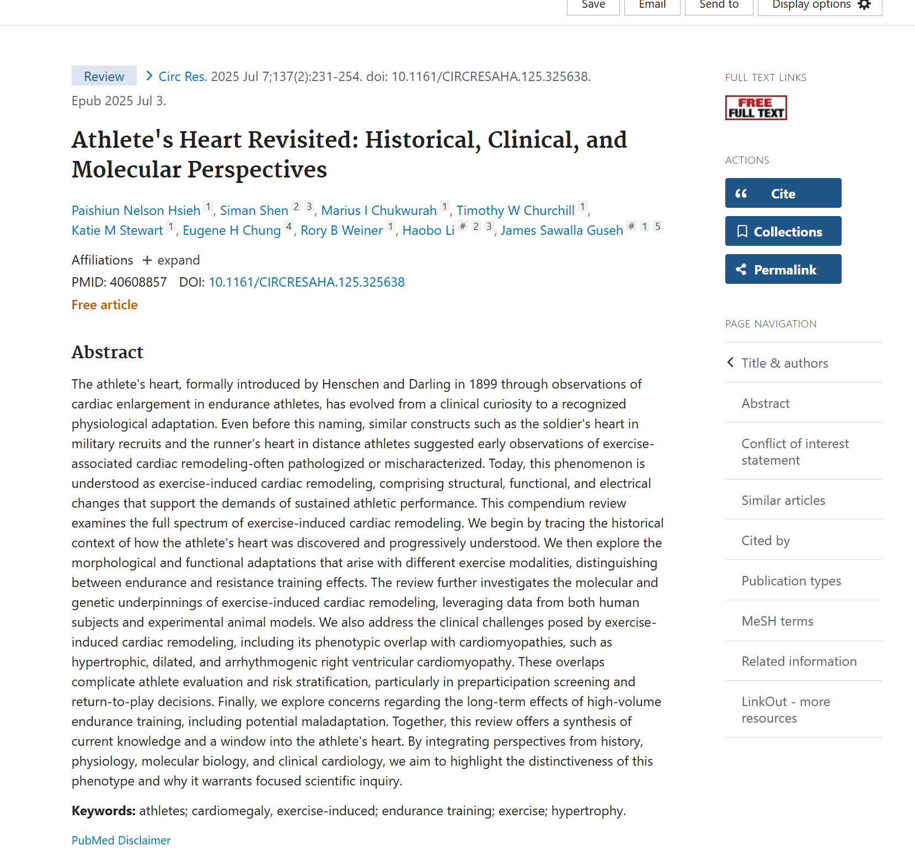
Sports Adaptations Induce or Mimic Disease

Slide 21
exercise-induced cardiac remodeling (EICR)—adaptive structural, functional, & electrical changes that enable the heart to meet sustained athletic demands.

Slide 22
EICR
Structural: Esp LV
Hypertrophy
Chamber
Supranormal Diastology (LV more relaxed, can fill more)
Function: more SV is a defining feature of EICR
VO2 peak = Q = HR (fixed; age, sex, genetics) vs. SV (extreme plasticity with exercise training).
SV increases via:
More ventricular filling
Lower end-systolic volume
Ejection Fraction
Electrical
Increased Vagal Tone: Lower RHR

Slide 23
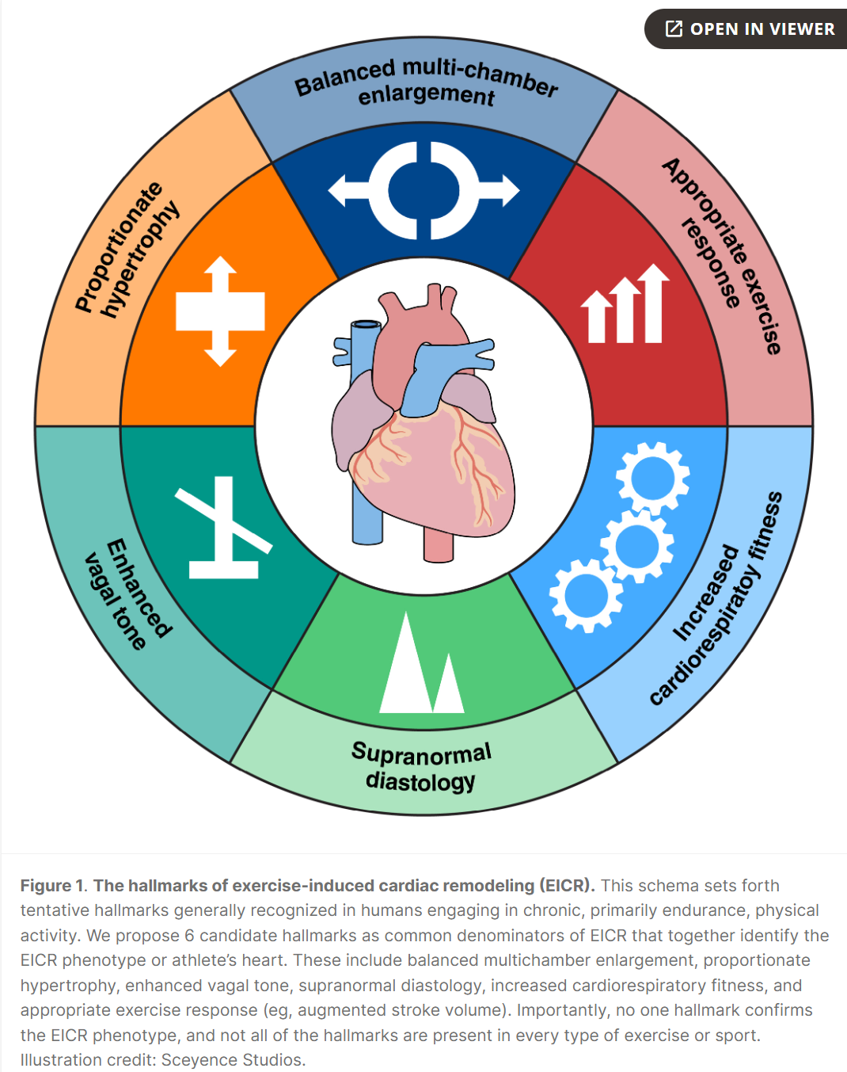
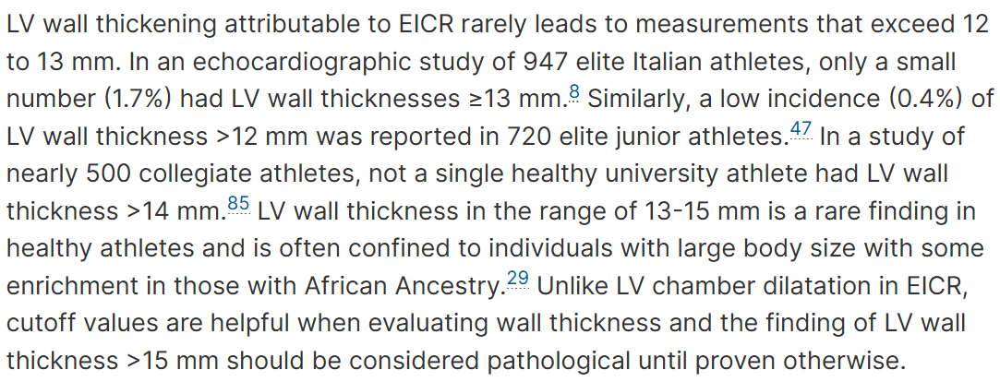

Slide 24
EICR Anatomical Adaptations: LV
things that enhance SV and thus aerobic performance
Chamber dilation
End-diastolic diameters often exceed normative cutoffs
Large cohort of Italian athletes, 45% had LV diameters >55 mm, 14% were > 60 mm
Similar results found in US athletes
Mild wall thickening
Common in RE athletes
Rarely > 12-13 mm
13-15 mm = gray zone, should evaluate to exclude HCM, disease, or other pathology
Asymmetrical hypertrophy, fibrosis, poor contractile reserve, abnormal diastolic function, etc.
May need to try detraining protocol to establish causality
Thus, LV size alone can’t differentiate EICR from cardiomyopathy

Slide 25
Specific Exercise Types = Specific EICR
“concentric” remodeling = high BP (lower chamber size)
“eccentric” = proportional increase in Vent size
Isotonic exercise (distance running, cycling, swimming, etc.):
sustained volume/Q challenge w/ normal or low peripheral resistance = balanced dilation of all 4 cardiac chambers
Rowers: tend to develop eccentric LV hypertrophy due to more pressure stress
Distance runners: eccentric LV hyper w/ normal LV mass
Isometric RE (lifting, wrestling, etc.)
Increased peripheral vascular resistance and modest elevations in Q
This combines to cause pressure overload = mild LV wall thickening w/o chamber dilation

Slide 26
Determinants of EICR: How Much It Happens
Sex: Females athletes show less EICR
Study: 600 elite female athletes = LV end-diastolic cavity dimensions and wall thickness were sig greater than sed controls but smaller compared to male athletes (even after adjusting for body size).
Ancestry/Genetics: Africans athletes show more LV wall thickness than European, w/ some individuals exceeding HCM thresholds
Note: MOST research is simply “white” vs. “black” which is bad…
Some emerging evidence of genetics poly’s explaining more vs. less EICR, but nothing really to stand on yet
Training Exposure: Duration, Type, Intensity
Initial remodeling is concentric, then eccentric w/ sustained exposure
Min threshold appears ~4-8 hr of intense training/wk in young athletes (remember, we’re not talking about function here, it’s structural remodeling)
Number is >5 hr/wk in older adults

Slide 27
EICR Anatomical Adaptations: RV
Typically gets eccentric remodeling-mild/moderate dilation w/o hypertrophy
RV enlargement is common/expected in endurance athletes
Just like LV, mild drops in RV systolic fnct at rest are common, but should happening w/ preserved or better contractile reserve
Limited normative data = no consensus on thresholds
RE = not well known
Some data suggest little changes, supporting idea that EICR in RV is driven by sustained volume rather than pressure (hence no change for RE athletes)

Slide 28
EICR Anatomical Adaptations: Atrial
Well established; AE have larger left atrial (LA)
Study: 600 athletes, LA volume much bigger than normal
Meta analy: 7,000 athlete vs. 1000 controls:
AE: 4.6 mm larger
AE+RE: 3.5 mm larger
RE: 2.9 mm larger
RA also well documented, similar conclusion as LA

Slide 29
EICR Anatomical Adaptations: Ejection Frac
90% of AE will have same or greater EJ, but 10% will have lower (EF<50%)
They usually still have excellent exercise capacity and contractility
suggesting low EF in this context is either a) irrelevant or b) sign of early cardiomyopathy
Some data suggest this is genetically driven
Higher PGS for LV end-sys volume index, consistent w/ genetic predisposition towards more chamber dimensions and lower EF
Ie. intense training may unmask subclinical genetic variants = extreme phentophy for EICR
Too early to know here though, so hold horses

Slide 30
ProHeart Studies:
Elite endurance athletes enrolled in the Pro@Heart (Prospective Athletic Heart) and ProAFHeart studies⁶
Subjects
281, 19 yr, mostly male, national/international level in AE sports, VO2 = 63, exercises 15-6 hr/wk
44 (16%) had reduced EF of either LV or RV
12 (4%) had reduced LVEF (<50%)
14 (5%) had reduced RV EF (<45%)
18 (6%) had reduced biventricular EF
Findings:
10% had low LVEF

Slide 31
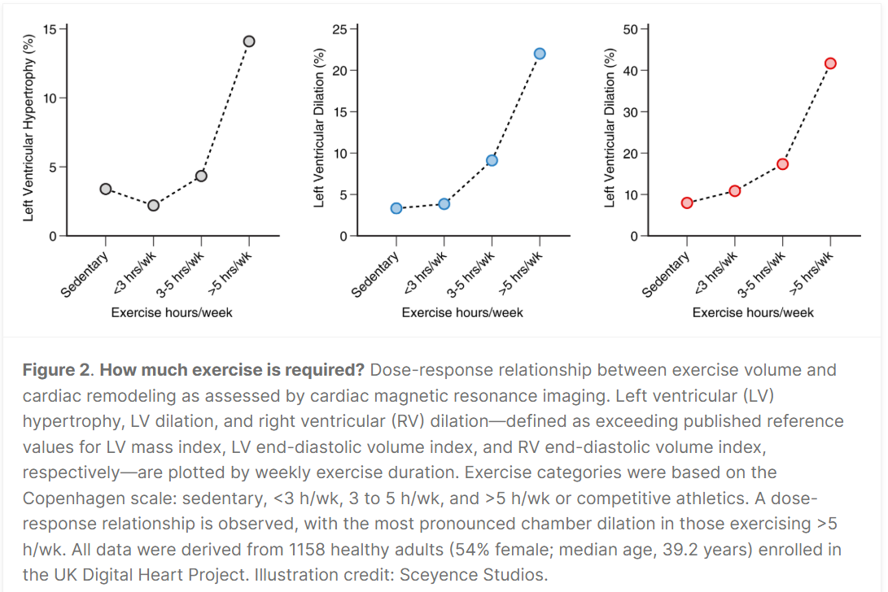

Slide 32
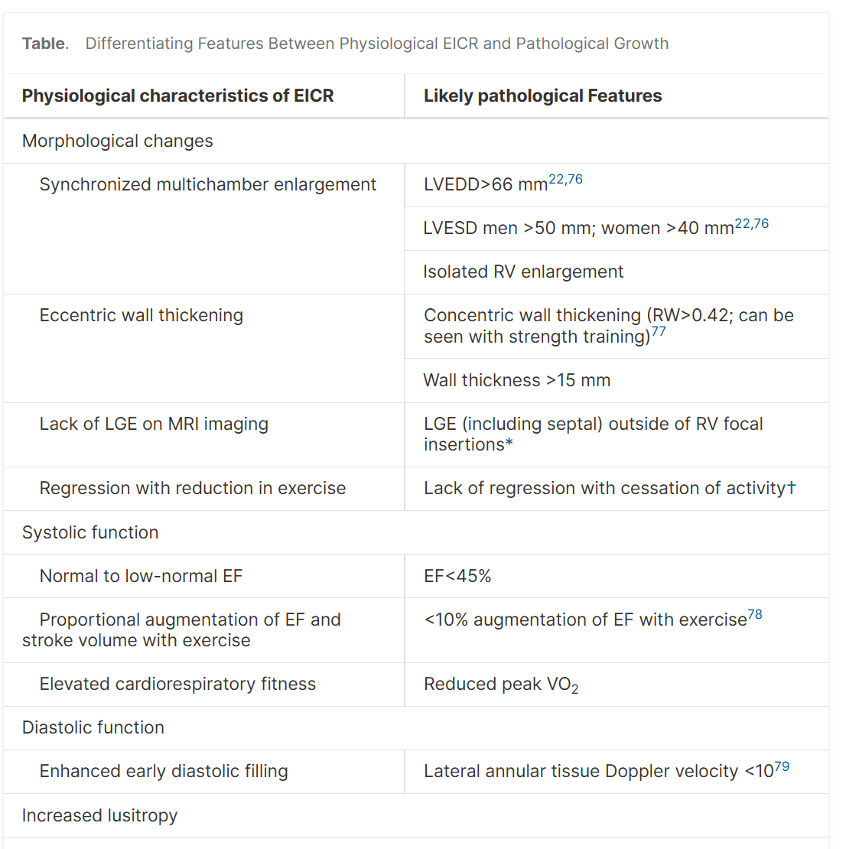
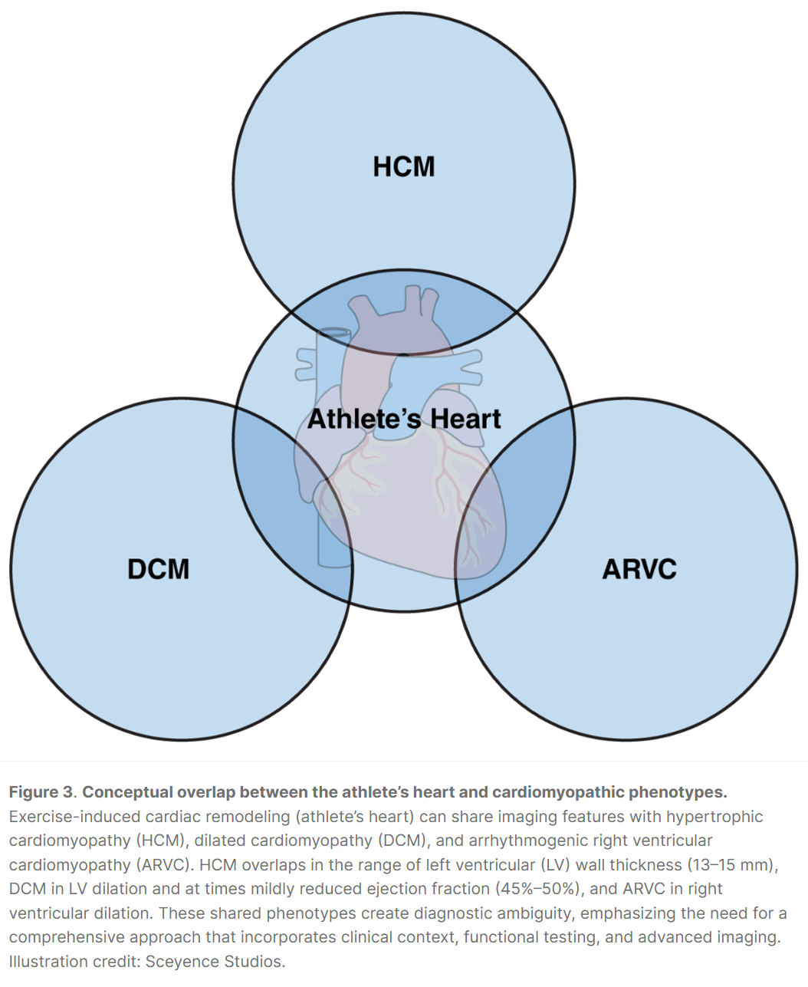

Slide 33
When It Goes Bad

Slide 34
The act (exercise) = almost always good
Taken to extreme, might = maladaptation
Arrhythmia risk:
Coronary artery calcification
Myocardial fibrosis

Slide 35
Arrhythmia risk: Seems most prevalent when you combine big volumes of both intensity and duration
Dose response study: 52,000 xc skiers in Sweden, those finishing race withing 60% of winners time were 1.3x more likely to A. Fib.
Ppl who did the race >5x also had 1.3x risk of AF vs. 1x participants
AE are people USUALLY absent of AF risk factors (hypertension, apnea, valvular heart disease, cardiomyopathy), but in reality, have 5x risk of AF (w/ male predominance)
Why?: repeated exposure to increased volume and pressure during prolonged exercise = LA enlargement and fibrosis
This benefits Q during exercise, but can also create chance of arrhythmias
AE also = more vagal tone, which prolongs atrial refractory periods & promotes bradycardia; both exacerbating AF chances
So in total, AE lowers risk of CV disease, but also increases risk of arrhythmias
HAS to be a function of risk predisposition vs. too much high-intensity exercise or whatever
Also, don’t lose the plot, slight bump in AF in exchange for massive drop in basically everything else = net is VERY POSITIVE
Example: Vasalopet study showed while increase risk of AF, they had 27% lower risk of stroke and 43% lower risk of mortality
Many unknowns with female athletes, most research in men
Tend to show less LA enlargement and fibrosis.

Slide 36
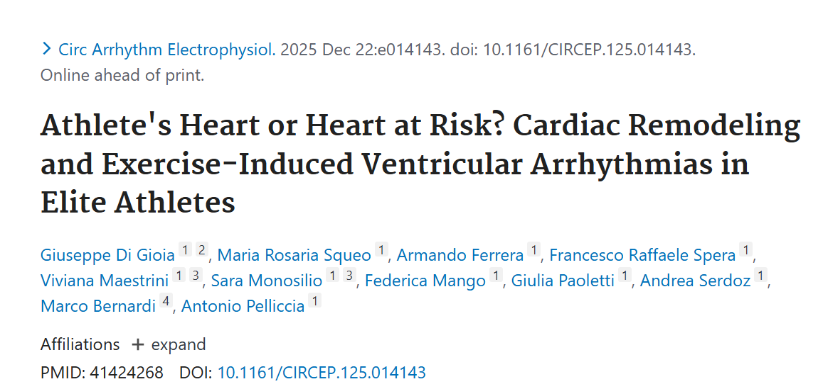

Slide 37
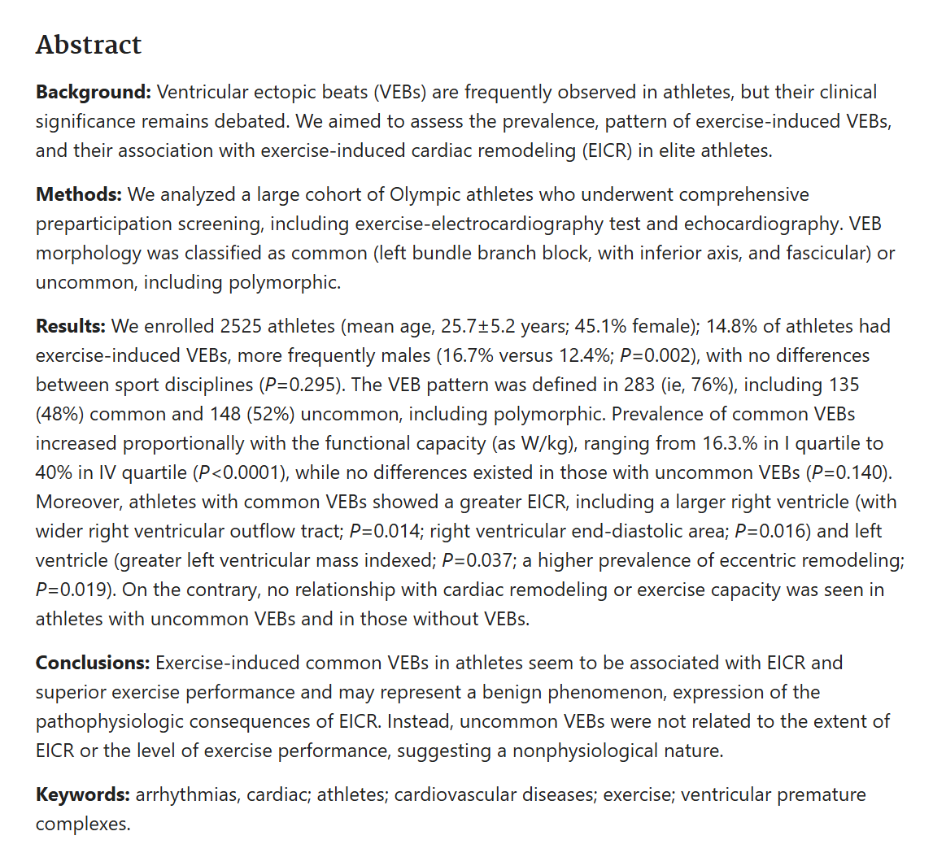

Slide 38
Coronary artery calcification
Athletes frequently show elevated CAC scores
Pathogenesis is unclear; could be…
Coronary hemodynamics; leading to endothelial dysfunction and plague formation
Chronic inflammation, sympathetic activation, mechanical vascular stress, EI increase in parathyroid hormone, etc.
Is this maladaptive atherosclerosis or benign vascular remodeling?

Slide 39
Coronary artery calcification
Some Risk: Cooper Clinic study: 26,000 ppl for 2 decades; higher CAC ass w/ more MI and revascularization, even among those w/ 3k MET-min per week of Physical activity
Thus, exercise lowered all-cause mortality, but did not mitigate CV event risk ass w/ CAC
Indicating that fitness offsets significance of anatomic diseases
Maybe Not: Levine suggests there is evidence that high levels of physical activity (≥3000 MET-min/wk) are associated with prevalent CAC but are not associated with increased all-cause or CVD mortality after a decade of follow-up, even in the presence of clinically significant CAC levels.
21 758 male participants
~30 miles per week at 10 min mile pace
Sex: Problem for men, women show no diff in CAC in athletes vs. controls
Notes:
https://pubmed.ncbi.nlm.nih.gov/30698608/ (Levine)
30k m is 5-6x upper limit of exercise guidelines
30 min of mod ex 5x/wk
12+ hr per week of moderate exercise or 6+ hr of vigorous
If you go for a run at 10:00/mile pace, that’s equivalent to an intensity of about 10 METs for the average person, which means you’re burning about 700 calories per hour. If you run for 60 minutes at that pace, you’ll have accumulated 600 MET-minutes of exercise (60 minutes times 10 METs). Put all that together, and you find that 3,000 MET-minutes works out to the equivalent of five hours of running at a 10:00-mile pace, or about 30 miles a week of running at that pace.

Slide 40
Myocardial fibrosis
New evidence suggests this might happen with high intensity exercise
MF: excessive deposits of extracellular matrix proteins & can occur in response to repetitive mechanical stress, inflammation, ischemia, or oxidative injury
Makes chambers stiff and less compliant
In AE we see it in atria, RV, septum, rather than in subendocardiam pattern that is typically associated w/ ischemic heart disease
Data on this topic are unclear and controversial, so jury is still out
Like always, seems more likely in male athletes vs. female

Slide 41
VENTOUX Studies
Close to HALF of veteran competitive endurance athletes (>50) have cardiac fibrosis, 5x higher risk of (non-benign) ventricular arrythmia, (that is, 20% of these).
Counter: This group was averaging 12hr per week for 20yrs, competing 20x a year... That's essentially 100mpw for 15+ years...basically doesn't apply to any runners except a very very small number of long-term elite marathoners... This study isn't for your average Joe or even your serious Joe.
"In contrast, there is also substantial evidence of exercise-related survival benefits in extreme endurance exercisers compared to the general population, including data from a large cohort of Scandinavian endurance athletes". You might stay away of making health recommendations
- Mike Joyner

Slide 42
Good vs. Bad Remodeling
Bad: Pathological cardiac hypertrophy, caused hypertension or myocardial infarction, progressively leads to adverse cardiac remodeling, fibrosis, and loss of cardiomyocytes, which eventually result in heart failure.^{95,96}
Concentric hypertrophy
LV thickening and slight drop in chamber size
Cardiac fibrosis, cell death, etc.
Good: physiological cardiac hypertrophy, seen in response to physiological stimuli such as exercise, leads to adaptive and reversible cardiac growth that does not generally cause adverse outcomes and protects the heart against stress.^{95–97}
Eccentric
Proportional changes in ventricular wall thickness & enlargement of chambers
Changes = same or better cardiac function and no fibrosis, cell death, etc.

Slide 43
Summary
Vo2max data: no upper limit
Amby Bumford (Runner’s World) “Where are the bodies?”
We just don’t see that many ppl who do even extreme exercise dying
FARRRR more for evidence of the opposite
Vfib kills, but we don’t see that in athletes
A fib doesn’t kill, so is there really an issue?
Afib still far less in exercisers than gen pop
men running at least 40 miles a week were 26% less likely to develop coronary heart disease than those meeting health guidelines by running just 13 miles a week.
Notes:
Runner’s World journalist Amby Burfoot

Slide 44
Survival Rate of Exercisers
Survival rates of 122,000 patients who received maximal treadmill testing at the Cleveland Clinic in Ohio between 1991 and 2014, published in JAMA Network Open.
Follow-up period of 8.4 years and a total of 13,637 deaths
greater fitness = greater probability of survival right to the very top of the spectrum.
Those with “elite” fitness (>97.7th percentile relative to their age and sex) = were only 20 percent as likely to die during the study as those with low fitness.
But even those with high fitness, in the 25%, were 29% more likely to die during the study compared to the elite group.
Notes:
https://jamanetwork.com/journals/jamanetworkopen/fullarticle/2707428

Slide 45
Extreme Exercisers
Data from Extreme Exercisers
2,088 men and women (53.2 y), exercised 35 hr/wk for 28.5 years.
10 yr follow up
2/66 died
Neither related to heart disease
Final Thought: Dr. Paul Thompson (MD): “intellectually interesting, clinically worth knowing, but not worth worrying about.”

Slide 46
Investigate

Slide 47
Free:

Slide 48
Targeted Screening
Most common sports: Rowing, running, cycling, swimming, skiing
Annual SCD risk: Reggie Lewis & Hank Gathers (1990’s)
black male college athletes 1 in 16,000
male basketball athletes 1 in 9,000
male black basketball athletes 1 in 4400.²
These rates are not ‘extremely rare’ but alarmingly high.
ANY family history of early heart disease (<50)
Likely single strongest predictor, yet, almost nobody takes it seriously
Joel Jamison (50% blockage)
AHA 12-step screening process
Do you faint, do you have chest discomfort while exercising
Sometimes looks like asthma

Slide 49
Cheap/Medium

Slide 50
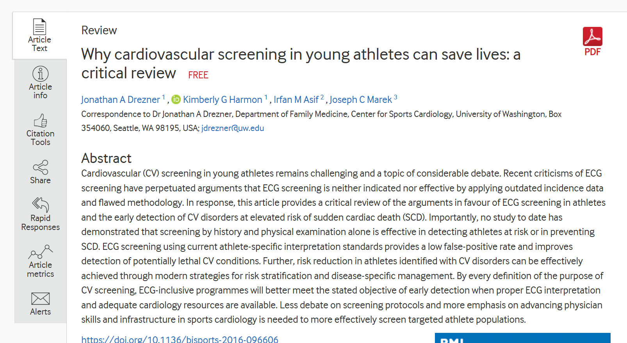
https://bjsm.bmj.com/content/50/22/1376.long

Slide 51


Slide 52
Apparently in Italy, all athletes, from elementary to pros – go through government funded ECG screening
Italy has ~2-3x number of doctors per capita as US, so not realistic here (US is also more diverse and simply has far, far more people than Italy to deal with)
Bc of this, you would end up with huge number of athletes being misdiagnosed and put on alter when they really don’t have to be, since people aren’t trained in sport cardiology, so everything would look like a disease vs. normal adaptation

Slide 53
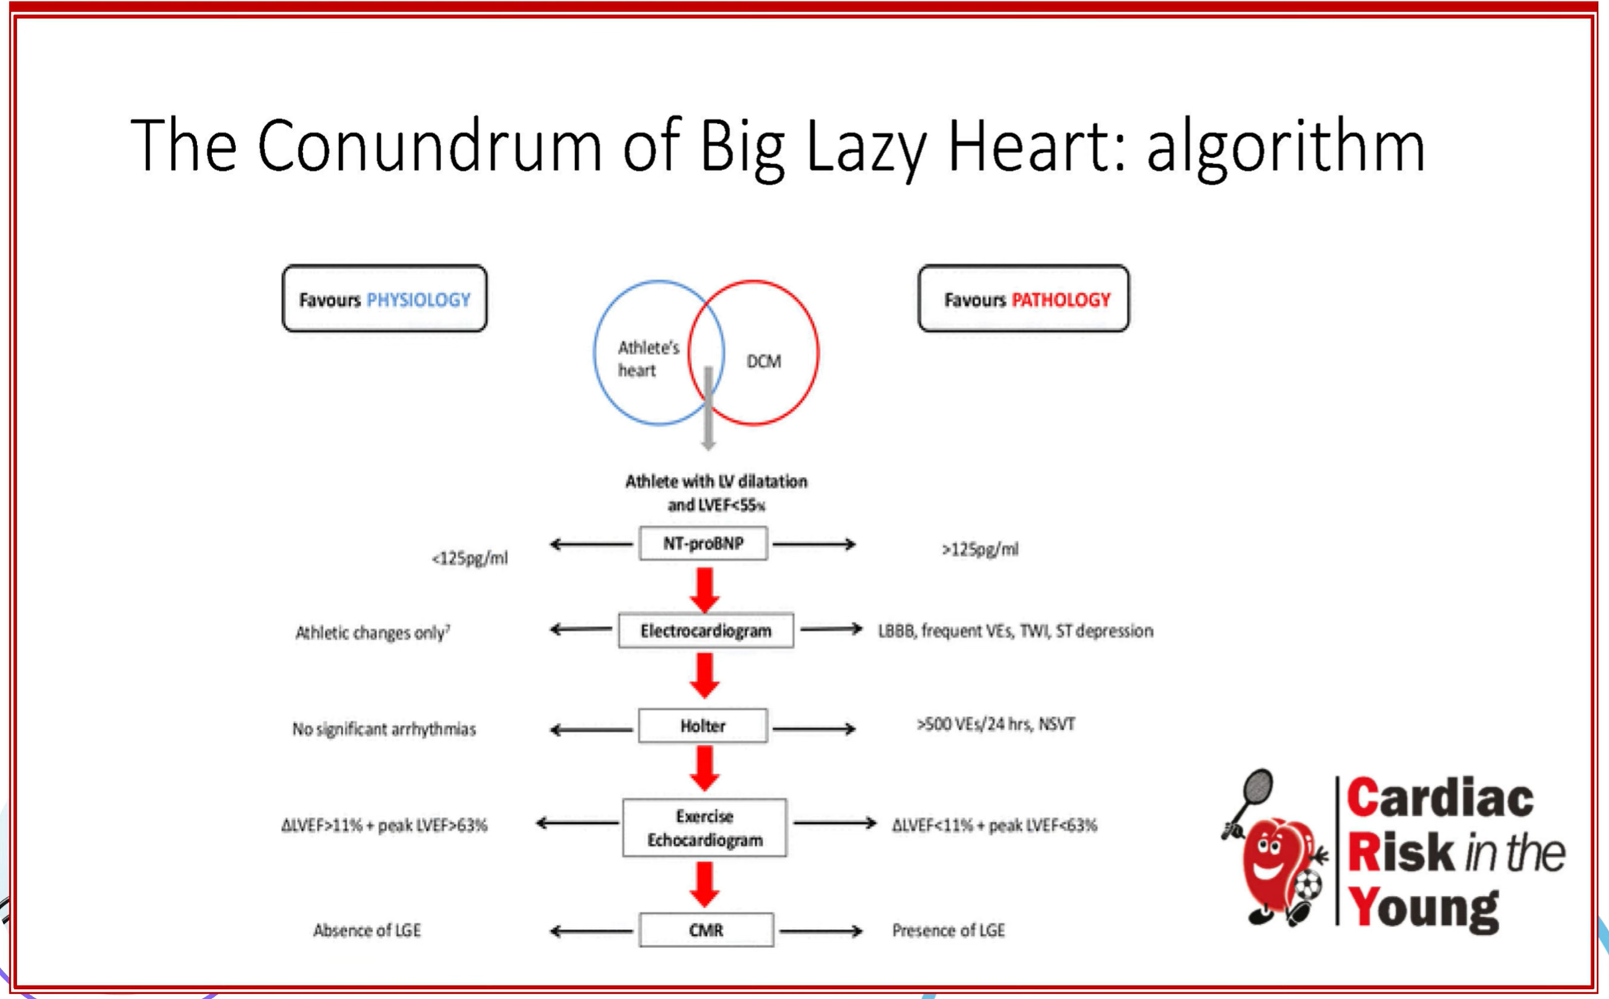

Slide 54
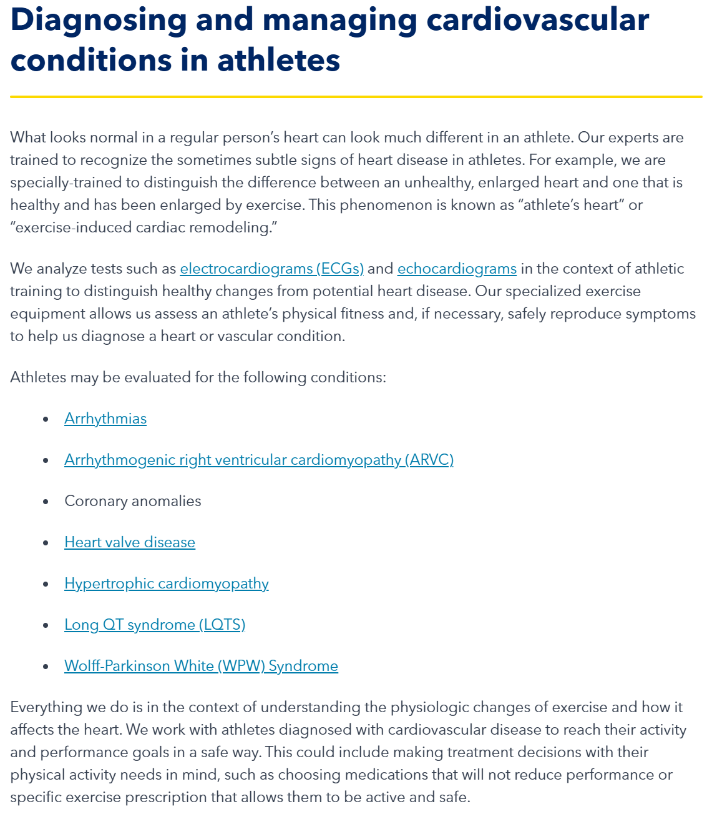
“Sports Cardiology” new field (20 years or so)
https://www.medstarhealth.org/services/sports-performance-cardiology

Slide 55

Coronary CT angiogram ($1,200)
Images coronary arteries on CT scanner
Calcium Score
Cleerly
FDA-cleared machine learning algorithms to non-invasively measure atherosclerosis (plaque), stenosis, and likelihood of ischemia using coronary computed tomography angiography (CCTA) studies.
Our machine-learning AI generates a 3D model of the patient’s coronary arteries, identifies their lumen and vessel walls, locates and measures stenoses, while quantifying and categorizing plaque.¹ Cleerly ISCHEMIA’s algorithm uses measurements based on invasive FFR data to determine the likelihood of vessel-level ischemia.²
Cost: $1,500-2,500

Slide 56
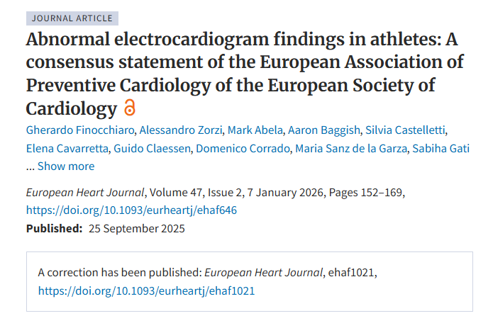
https://academic.oup.com/eurheartj/article/47/2/152/8263812?login=false

Slide 57
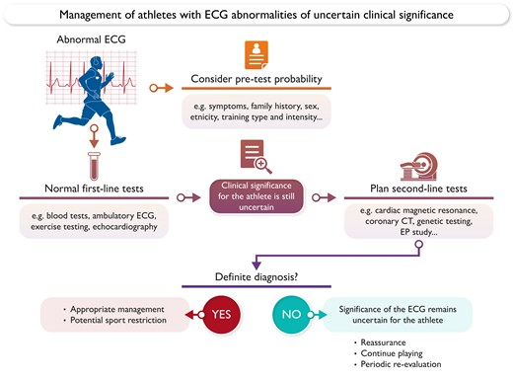

Slide 58
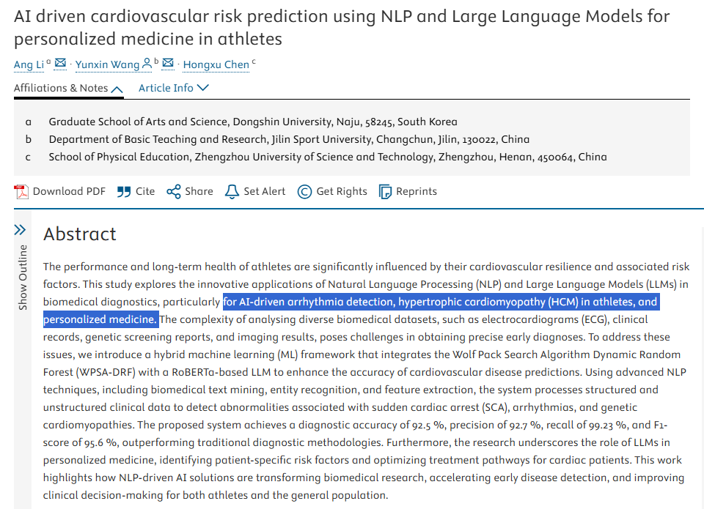
https://www.slas-technology.org/article/S2472-6303(25)00044-5/fulltext

Slide 59
Intervene

Slide 60
Free:

Slide 61
Misc
Detrain and See:
May ask you to stop training for 3 months then reimage, that’s the only way to establish causality vs. genetics
“a study found 20% of former athletes still have enlarged LV 5 yr later”
Exercise Limit: 1 hr per day
No strong argument that more than that is NECESSARY for great health
However, if you choose to go past this, for whatever reason, than you need to proactivity monitor heart health, CAN’T just assume it’s ok
Can’t just assume because your VO2 is high
Can’t just assume bc your blood lipid panel is good
HAVE to get multiple forms of imaging

Slide 62
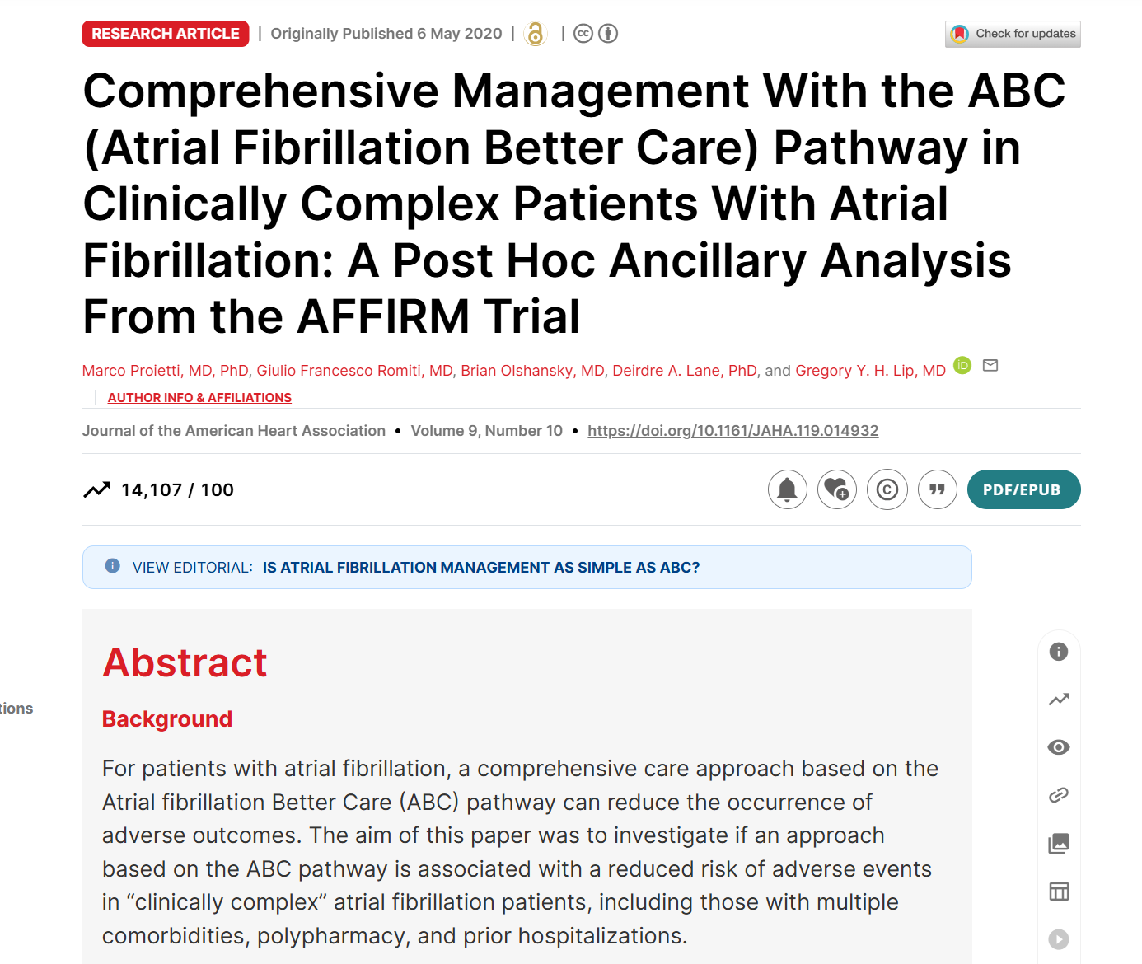
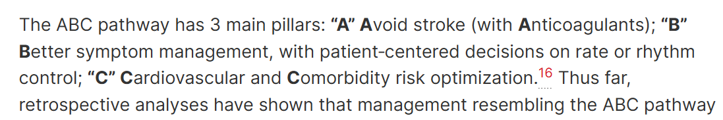

Slide 63
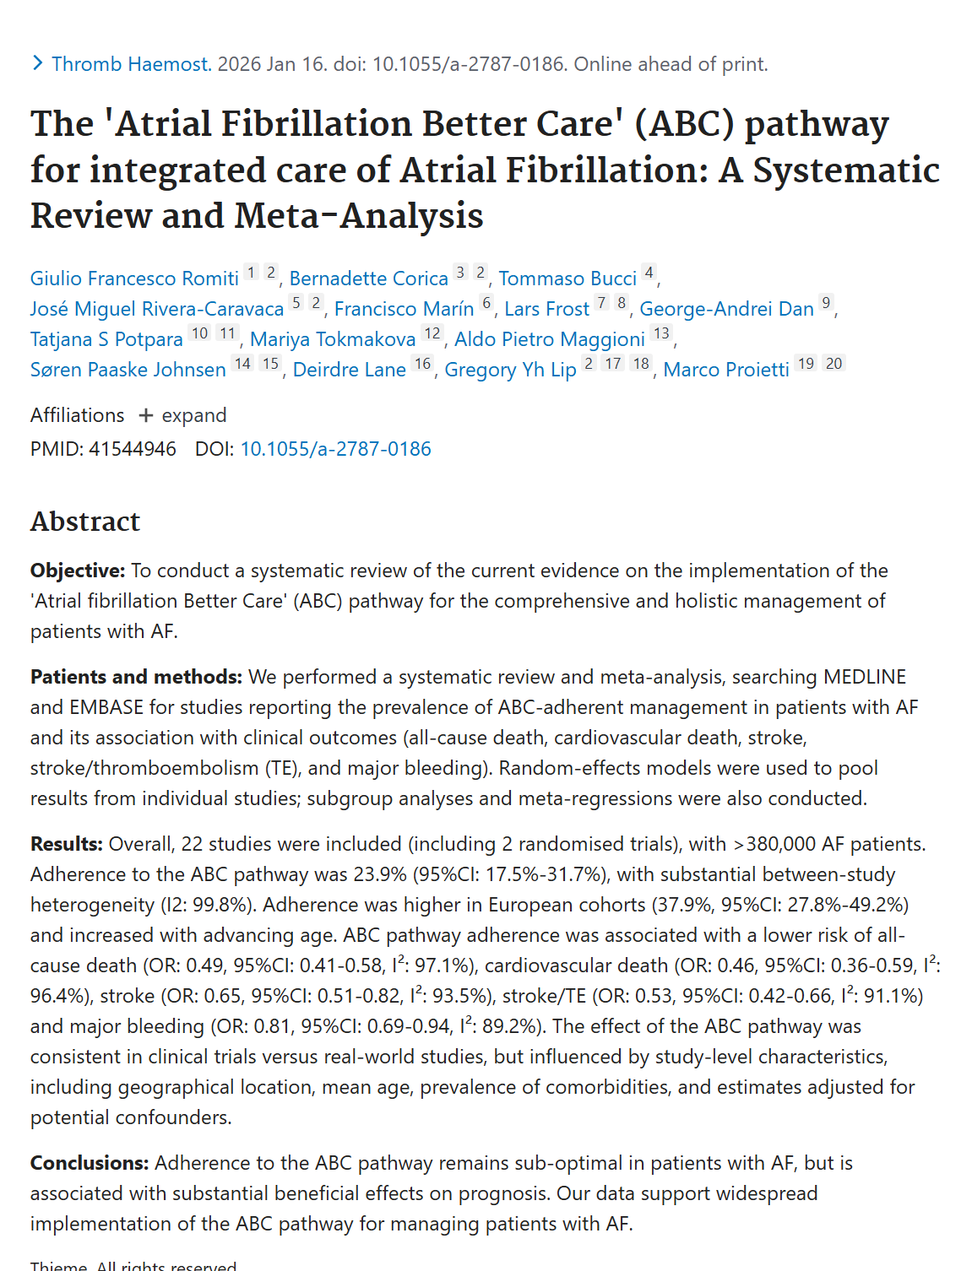

Slide 64
Cheap/Medium

Slide 65
Medium Cost Interventions
AED being around have massively reduced sudden cardiac death
implantable cardioverter defibrillator (ICD).
It stands sentinel inside the chest, and if it detects an abnormal heart rhythm it delivers about a 750-volt shock.
Not pleasant, but it’ll save a life.
In this video, you can see soccer pro Anthony Van Loo collapse on the field, and then a few seconds later he jerks when the ICD shocks him, and then he sits up.

Slide 66
Summary & Conclusion

Slide 67
“Too Much Exercise” is Bad Trope
Comes and goes every few years
Paper comes out, athlete dies, makes headlines
Story hasn’t changed
David Epstein, Alex Hutchingson, Mike Joyner

Slide 68
Summary
same mechanisms that confer benefit—
cardiac enlargement
vascular compliance
enhanced metabolic flexibility
may under certain conditions contribute to
arrhythmias
coronary calcification
myocardial fibrosis
Is It Worth IT then?

Slide 69
Is it Worth It?
Human VO2 peak is a species defining characteristic
Almost 5x greater than our closest primate relatives
They’re built for strength, we’re built for endurance
Longevity
From London bus study to all the recent research, it obviously plays a big role in human health
Cardiac Rehab programs are ultra effective

Slide 70
Is it Worth It?
My Conclusion: Does NOT negate the profound benefits of exercise, but rather emphasize the need for personalized interpretation of findings for highly trained individuals
IF EXTREME: pay very close attention, get imaging & testing, and monitor with a sport cardiologist or similar
Those exercising >60 min a day likely have other reasons than just health, so we need to factor that in
Very limited reason to firmly say this is bad for your heart
It COULD be, but data here are fairly rare, it’s NOT a promise that it is
Testing is not simple; the promise of genetic testing is emerging, but it’s not here yet IMO

Slide 71
Gold Standard: Soap Box
Critical we study elite athletes and exceptional performers
If we didn’t study world champion AE and people like Caballa, we NEVER know about EICR; it would all be a disease
Exercise Science is a field as critical and necessary as any human health field in the world
Because if you have a body friends, you are an athlete, like it or not

Slide 72
Notes

Slide 73
Athlete’s Heart:
https://pubmed.ncbi.nlm.nih.gov/40608857/

Slide 74
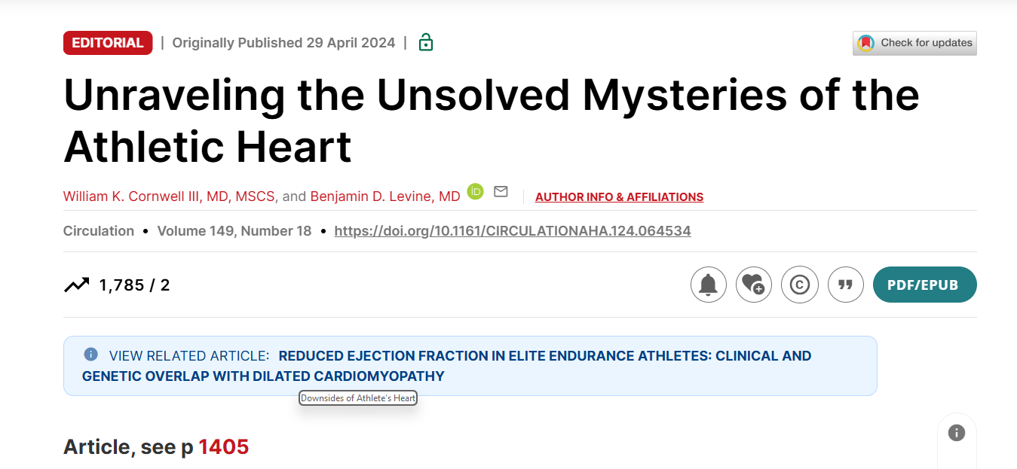

Slide 75
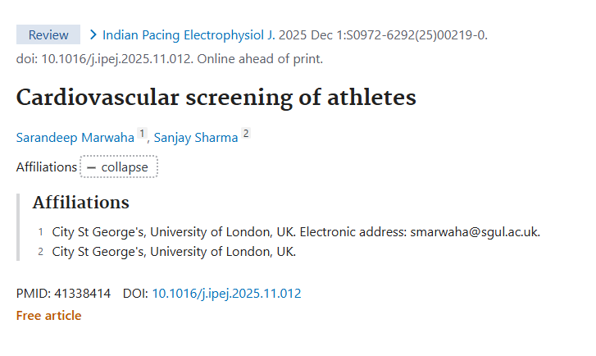
Cardiac Risk in Young: Project

Slide 76
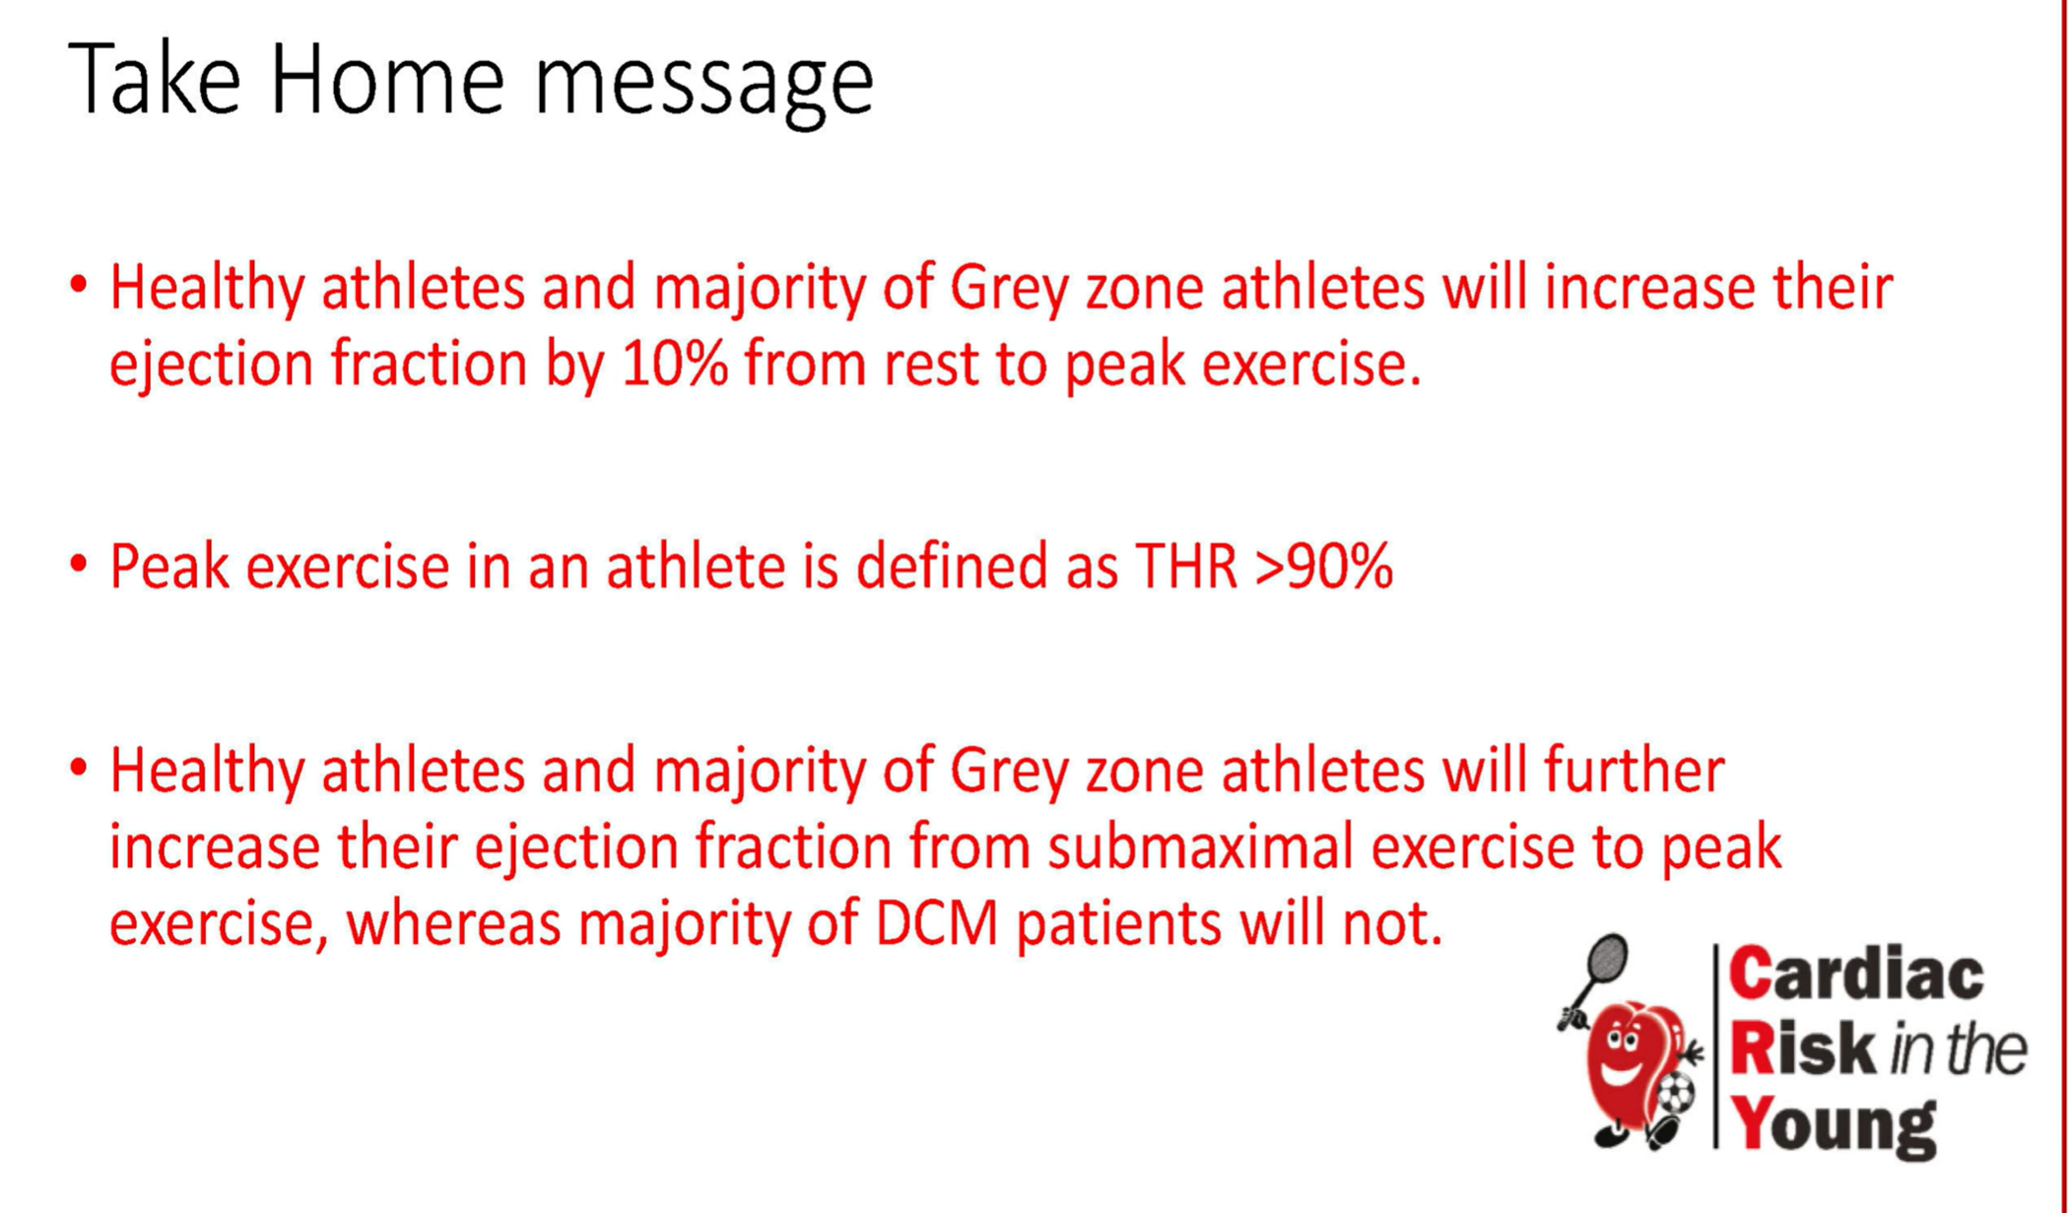

Slide 77
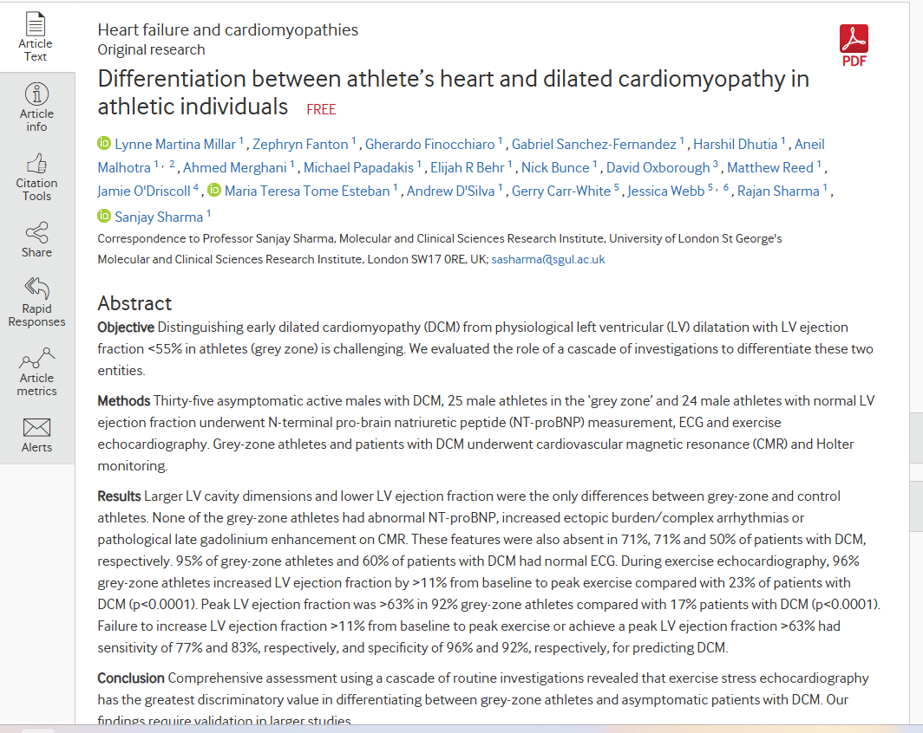
https://heart.bmj.com/content/106/14/1059

Slide 78
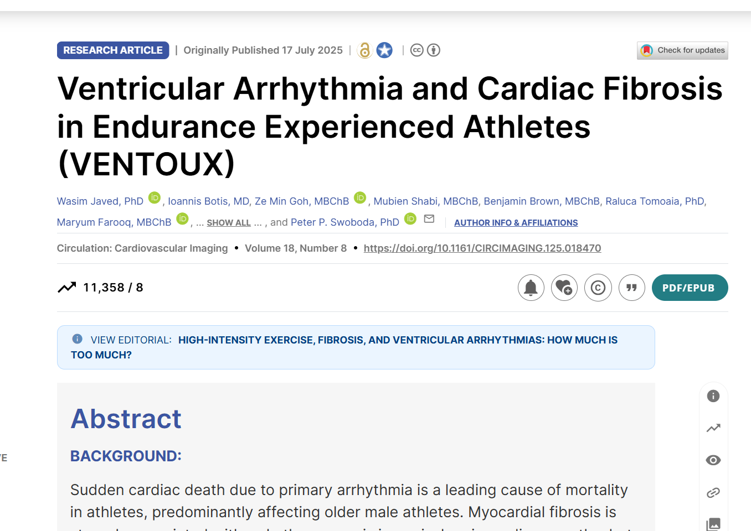
Notes:
https://www.ahajournals.org/doi/10.1161/CIRCIMAGING.125.018470

Slide 79
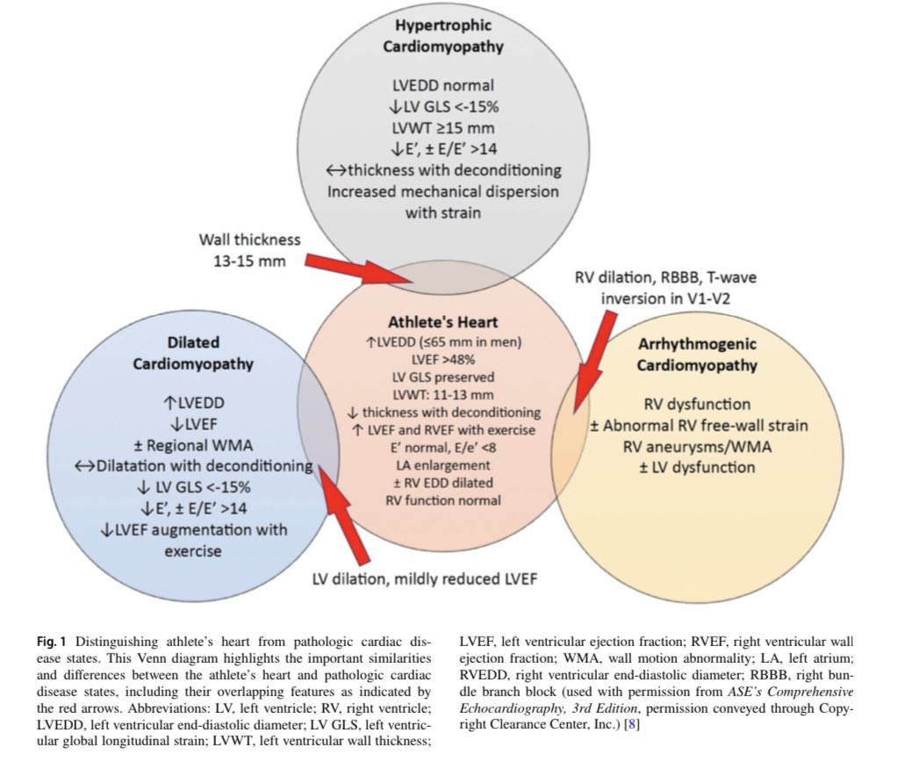

Slide 80
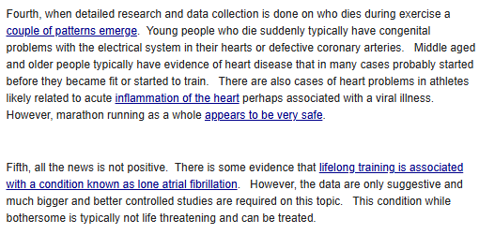

Slide 81
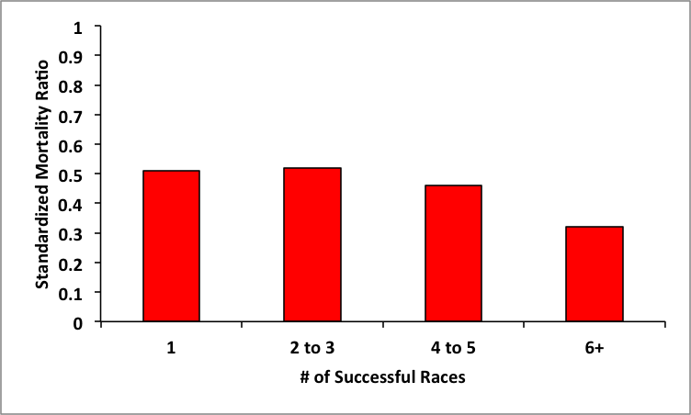
Mike Joyner
The idea is that moderate levels of physical activity most days with occasional bouts of strenuous activity can cause big drops in both cardiovascular and all-cause mortality. However, doing a lot of hard training is not as beneficial. This topic has been recycling for the last couple of years
there are many limitations to the whole argument
30-60 minutes of physical activity most days is the sweet spot for general health and that more is not better, but it is not worse either.
https://pubmed.ncbi.nlm.nih.gov/12603494/ Vasaloppet 2003 Ekblom study
Surprise, they live long
Our study
mortality is about 50% or less than predicted for race finishers compared to the expected rate gleaned from Swedish population records. It also shows that finishing more races was not associated with an uptick in mortality, if anything it was associated with a down tick. Who knows exactly what these folks were doing, but those who finished a number of races certainly had to be doing a lot of strenuous training over many years.
These data are as strong or stronger than any other data with similar design showing an increasd risk; both sides are working on assumptions

Slide 82
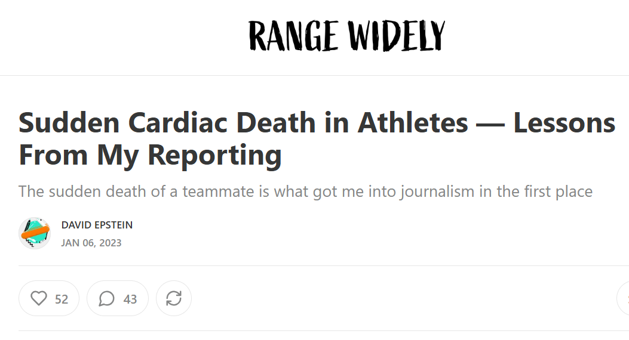

Slide 83
David Epstein
This is apparently why he turned into a science writer, his friend died of this
Kevin died of hypertrophic cardiomyopathy, or HCM. HCM is usually described as an enlargement of the heart, which is true, but specifically the enlargement is in the wall of the heart’s left ventricle
it is sometimes cited as the most common cause of sudden cardiac death in people under 35.
About 1 in 500 people have it, but few will drop dead, and many will never even know.
Genetics of HCM: Very complicated, not a single marker or combination that we know of, not something we can easily just screen for – so while it is caused by a single mutation, it’s not easy to find
Hence his motto from sports Gene: Genetics are more complicated than he thought
Thus; we should screen kids with ECG!
Apparently in Italy, all athletes, from elementary to pros – go through government funded screening
Italy has ~2-3x number of doctors per capita as US, so not realistic here (US is also more diverse and simply has far, far more people than Italy to deal with)
Bc of this, you would end up with huge number of athletes being misdiagnosed and put on alter when they really don’t have to be, since people aren’t trained in sport cardiology, so everything would look like a disease vs. normal adaptation

Slide 84
Promises of Genetics and Precision Medicine
https://www.jci.org/articles/view/126119
In 1999 Francis Collins published a foundational document of precision medicine entitled “Medical and Societal Consequences of the Human Genome Project,”(1) which made predictions about the ways the human genome would be used to predict, prevent, and treat disease in 2010. In 2000, he suggested that “Over the longer term, perhaps in another 15 or 20 years, you will see a complete transformation in therapeutic medicine” (2).

Slide 85
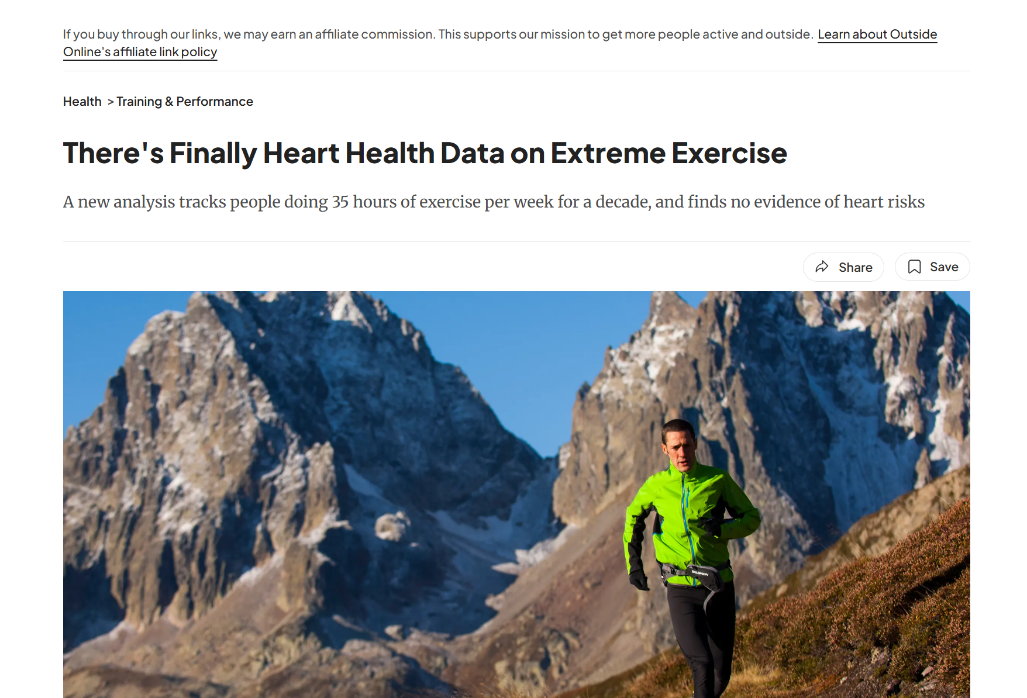
https://www.outsideonline.com/health/training-performance/extreme-exercise-heart-health-study/

Slide 86
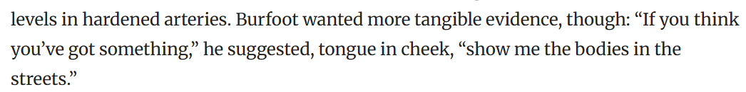
Alex Hutchinson; 2019
Back in 2011, former Boston Marathon champion and longtime Runner’s World journalist Amby Burfoot interviewed a leading cardiologist about emerging claims that too much running might be bad for your heart. The controversy hadn’t really blown up yet, and it wasn’t until the following year that the scary headlines hit mainstream media outlets: “One Running Shoe in the Grave,” “Running Farther, Faster and Longer Can Kill You,” and so on.

Slide 87
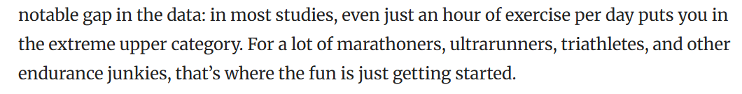
https://pubmed.ncbi.nlm.nih.gov/30698608/ (Levine)
Conclusions and relevance: This study suggests there is evidence that high levels of physical activity (≥3000 MET-min/wk) are associated with prevalent CAC but are not associated with increased all-cause or CVD mortality after a decade of follow-up, even in the presence of clinically significant CAC levels.
21 758 male participants
30k m is 5-6x upper limit of exercise guidelines
30 min of mod ex 5x/wk
12+ hr per week of moderate exercise or 6+ hr of vigorous
If you go for a run at 10:00/mile pace, that’s equivalent to an intensity of about 10 METs for the average person, which means you’re burning about 700 calories per hour. If you run for 60 minutes at that pace, you’ll have accumulated 600 MET-minutes of exercise (60 minutes times 10 METs). Put all that together, and you find that 3,000 MET-minutes works out to the equivalent of five hours of running at a 10:00-mile pace, or about 30 miles a week of running at that pace.
Another study, it includes a bunch of truly hardcore endurance athletes who were averaging more than five hours of exercise per day and had been doing it for decades. The good news: their hearts for the most part looked fine
In that data, they looked at the highest exercisers, 2,088 men and women with high physical activity levels (more than 3,000 MET-minutes per week) to 66 men and women with “extraordinary” physical activity levels (more than 10,000 MET-minutes per week). Burfoot, for his curiosity, is listed as the seventh author of the study, and wrote an account of the findings in the Washington Post.
As an aside, it’s interesting that some earlier studies start by defining anything greater than 60 to 90 minutes of exercise per day as “excessive endurance exercise” (EEE), a definition that more or less assumes its own conclusions. The fact that the new study instead uses the term “extraordinary” offers us a telling hint of where the researchers’ sympathies lie.
They had an average age of 53.2, exercised on average 35.1 hours and accumulated 13,921 MET-minutes per week, and had been exercising for an average of 28.5 years.
After an average of 10 years of follow-up, two of the 66 extraordinary exercisers had died. Neither of the deaths were related to heart disease or other cardiovascular conditions. Overall, the results for the extraordinary group looked pretty much identical to the plain old high exercise group.

Slide 88
https://pubmed.ncbi.nlm.nih.gov/30698608/ (Levine)
Conclusions and relevance: This study suggests there is evidence that high levels of physical activity (≥3000 MET-min/wk) are associated with prevalent CAC but are not associated with increased all-cause or CVD mortality after a decade of follow-up, even in the presence of clinically significant CAC levels.
21 758 male participants
30k m is 5-6x upper limit of exercise guidelines
30 min of mod ex 5x/wk
12+ hr per week of moderate exercise or 6+ hr of vigorous
If you go for a run at 10:00/mile pace, that’s equivalent to an intensity of about 10 METs for the average person, which means you’re burning about 700 calories per hour. If you run for 60 minutes at that pace, you’ll have accumulated 600 MET-minutes of exercise (60 minutes times 10 METs). Put all that together, and you find that 3,000 MET-minutes works out to the equivalent of five hours of running at a 10:00-mile pace, or about 30 miles a week of running at that pace.
Another study, it includes a bunch of truly hardcore endurance athletes who were averaging more than five hours of exercise per day and had been doing it for decades. The good news: their hearts for the most part looked fine
In that data, they looked at the highest exercisers, 2,088 men and women with high physical activity levels (more than 3,000 MET-minutes per week) to 66 men and women with “extraordinary” physical activity levels (more than 10,000 MET-minutes per week). Burfoot, for his curiosity, is listed as the seventh author of the study, and wrote an account of the findings in the Washington Post.
As an aside, it’s interesting that some earlier studies start by defining anything greater than 60 to 90 minutes of exercise per day as “excessive endurance exercise” (EEE), a definition that more or less assumes its own conclusions. The fact that the new study instead uses the term “extraordinary” offers us a telling hint of where the researchers’ sympathies lie.
They had an average age of 53.2, exercised on average 35.1 hours and accumulated 13,921 MET-minutes per week, and had been exercising for an average of 28.5 years.
After an average of 10 years of follow-up, two of the 66 extraordinary exercisers had died. Neither of the deaths were related to heart disease or other cardiovascular conditions. Overall, the results for the extraordinary group looked pretty much identical to the plain old high exercise group.

Slide 89
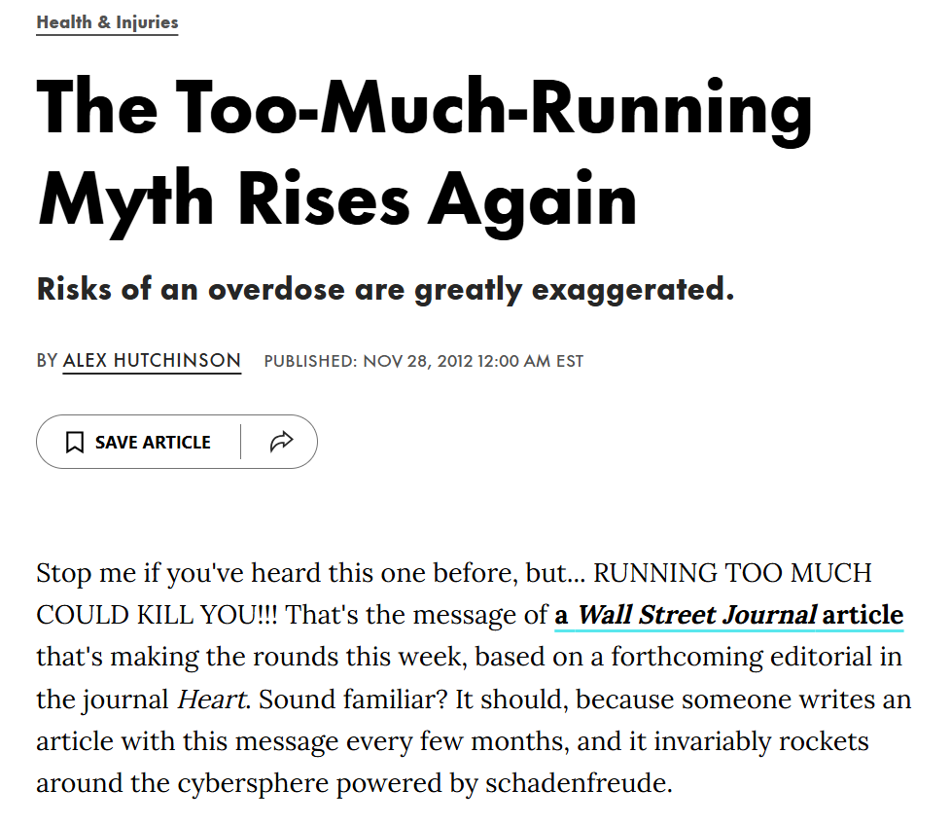

Slide 90
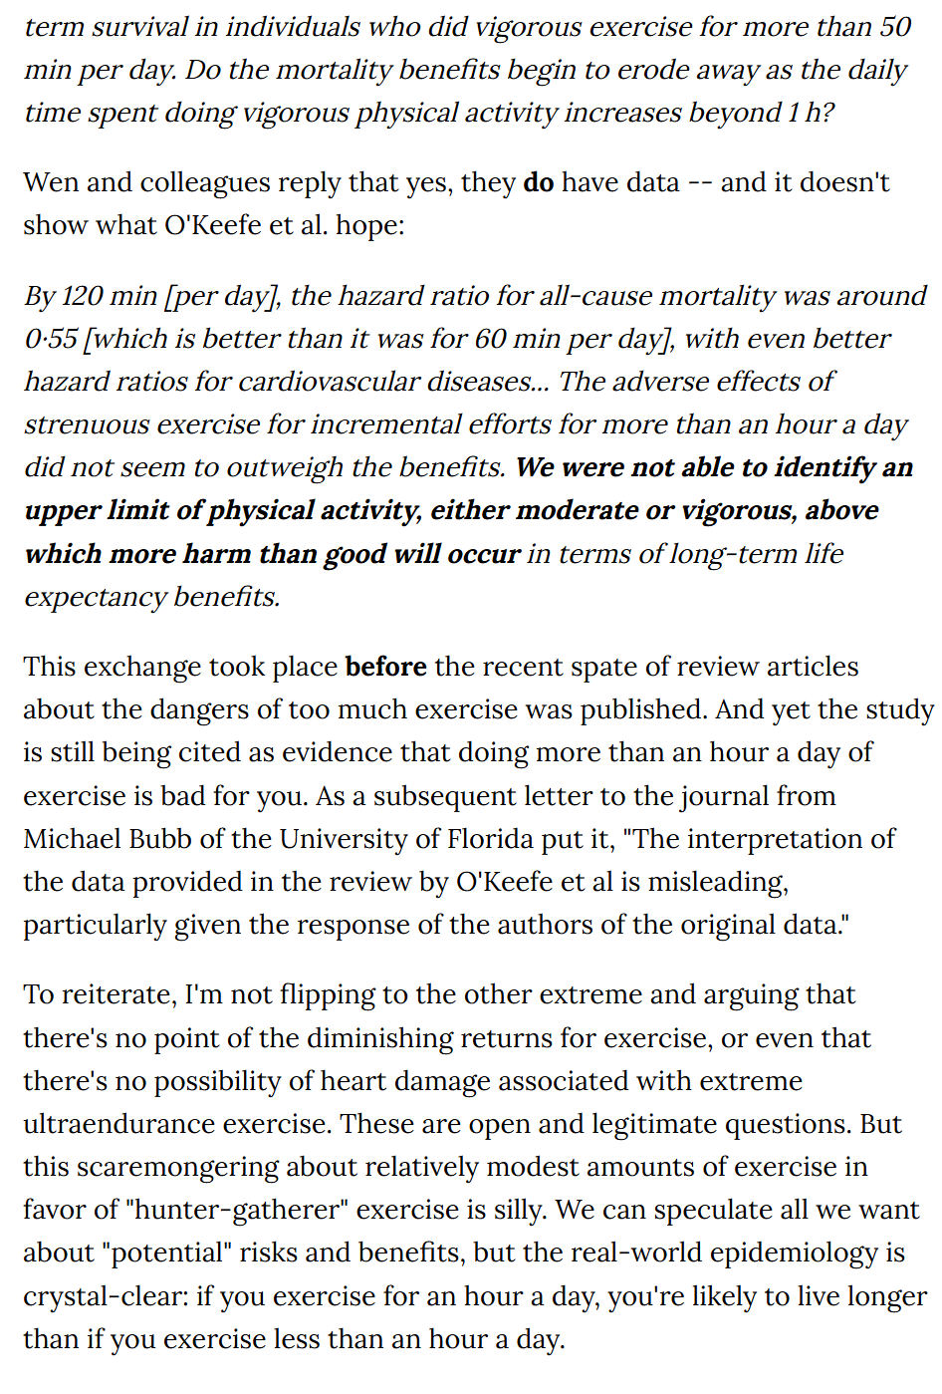

Slide 91

https://www.runnersworld.com/runners-stories/a20823603/what-to-know-about-running-and-your-heart/

Slide 92
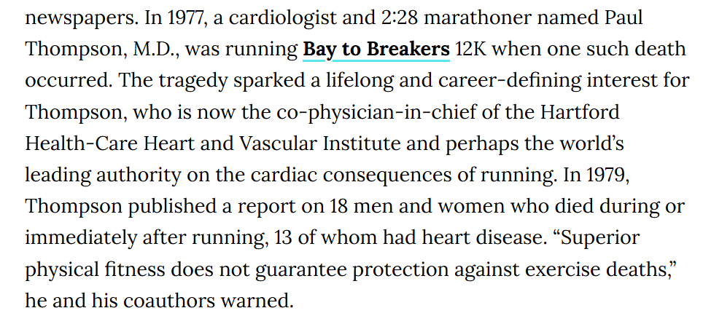

Slide 93
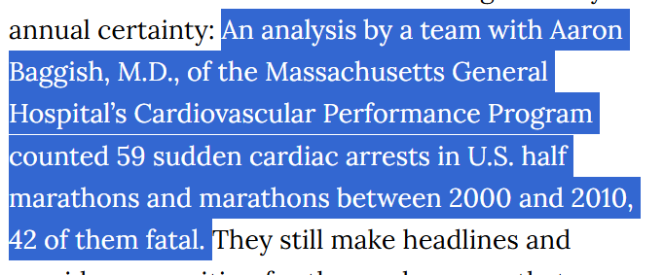
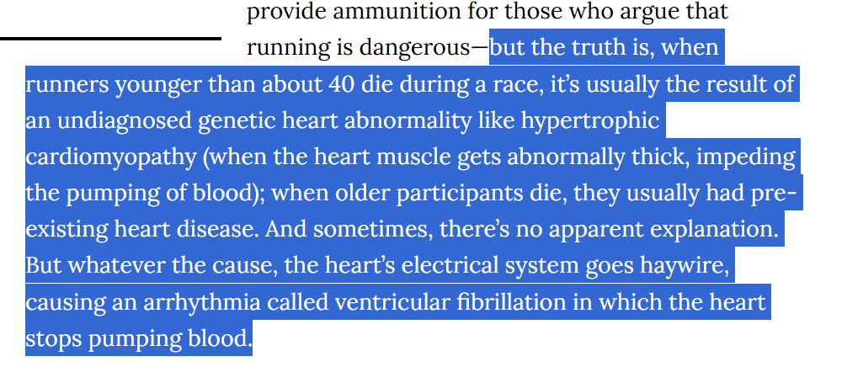

Slide 94
hat if it turned out that running at least 40 miles a week would extend life by two years for 99 percent of people, but shorten it by 10 years for the other 1 percent? Would you carry on? What if, instead, the proportions were 99.9 percent and .1 percent? Such decisions are deeply uncomfortable, which is why we avoid thinking about them when we, say, take an antibiotic or step outside on a sunny day. That’s why, for Thompson, the fruits of the debate are “intellectually interesting, clinically worth knowing, but not worth worrying about.”

Slide 95
The argument that running is bad
2012 ACSM in SF: I was There!
A team led by Duck-chul Lee, Ph.D., an epidemiologist then at the University of South Carolina, presented an analysis of more than 50,000 patients who had visited the Cooper Clinic in Texas between 1971 and 2002, including 14,000 who reported running as one of their regular activities. The good news: Within an average follow-up period of 15 years from their initial visit, the runners were 19 percent less likely to have died than the nonrunners. The bad news: Those benefits accrued primarily to men and women running less than 20 miles per week. Those who ran more than this seemingly modest threshold were statistically no better off than the nonrunners.
same week, a review by Kansas City cardiologist James H. O’Keefe, M.D., and several colleagues was published in the Mayo Clinic Proceedings, summarizing the potential negative cardiac effects of too much running: fibrosis, calcified arteries, arrhythmias.
Lee and his colleagues finally published their Cooper Clinic data in the Journal of the American College of Cardiology in 2014, more than two years after it was first presented at the ACSM meeting. In its peer-reviewed version, the data was presented without the controversial statistical adjustment—and the message was very different. Instead of warning about the dangers of running more than 20 miles a week, the authors emphasized the benefits of a very modest amount of running—five to 10 minutes a day—which created a dramatically lower risk of dying from heart disease. Running more than that didn’t offer further benefits, but neither, in the revised analysis, did it make things obviously worse.

Slide 96

https://www.outsideonline.com/health/training-performance/dont-worry-about-exercising-too-much/
https://jamanetwork.com/journals/jamanetworkopen/fullarticle/2707428
t’s a massive analysis of the survival rates of 122,000 patients who received maximal treadmill testing at the Cleveland Clinic in Ohio between 1991 and 2014, published in JAMA Network Open.
ith an average follow-up period of 8.4 years and a total of 13,637 deaths, greater fitness conferred greater probability of survival right to the very top of the spectrum. Those with “elite” fitness, defined as above the 97.7th percentile relative to their age and sex, were only 20 percent as likely to die during the study as those with low fitness—impressive, but no surprise. But even those with high fitness, in the top quartile, were 29 percent more likely to die during the study compared to the elite group.

Slide 97
The argument that running is bad
2012 ACSM in SF: I was There!
A team led by Duck-chul Lee, Ph.D., an epidemiologist then at the University of South Carolina, presented an analysis of more than 50,000 patients who had visited the Cooper Clinic in Texas between 1971 and 2002, including 14,000 who reported running as one of their regular activities. The good news: Within an average follow-up period of 15 years from their initial visit, the runners were 19 percent less likely to have died than the nonrunners. The bad news: Those benefits accrued primarily to men and women running less than 20 miles per week. Those who ran more than this seemingly modest threshold were statistically no better off than the nonrunners.
same week, a review by Kansas City cardiologist James H. O’Keefe, M.D., and several colleagues was published in the Mayo Clinic Proceedings, summarizing the potential negative cardiac effects of too much running: fibrosis, calcified arteries, arrhythmias.
Lee and his colleagues finally published their Cooper Clinic data in the Journal of the American College of Cardiology in 2014, more than two years after it was first presented at the ACSM meeting. In its peer-reviewed version, the data was presented without the controversial statistical adjustment—and the message was very different. Instead of warning about the dangers of running more than 20 miles a week, the authors emphasized the benefits of a very modest amount of running—five to 10 minutes a day—which created a dramatically lower risk of dying from heart disease. Running more than that didn’t offer further benefits, but neither, in the revised analysis, did it make things obviously worse.

