Slide 1
Intro/Hook

Slide 2
6 Month $1M Challenge: 1. Weight Belt or No? 2. Bench Press vs. Crunchies 3. Machines vs. Unstable/DB’s? 3. Every day or 2-3x per week?

Slide 3
Why Do We Train Abs Differently Than Other Muscles?
Think about this, abs are routinely one of the top visual things men and women desire, but as the stat goes, there are more millionaires then people with six packs?
Why do people struggle so much to develop abs?

Slide 4
Everyone wants nice looking and strong abs
Go to gym, do your training, then finish with 3x10 crunchie or side planks, and wonder why we don’t make any improvements
Willing to bet, if you’ve failed to make progress in this area, you’re probably making a few very common mistakes – that are easily correctable
Understanding Core vs. Abs

Slide 5
Why People Do Differently
1960-70s
Joe Weider & Arnold = big proponents of high volume and frequency
1980’
Jane Fonda & pilates, 8 min abs, etc,
Hershal Walker (3,500)
1990-2000
Janda, McGill , etc. = spine health

Slide 6
What is the Core?
Abs: Aesthetics
Big 3
Rectus abdominus = 6 pack
Core
Abs + pelvic floor + diaphragm + ribs
Back (Erector, multifidus (deep spine), QL (deep low back), lateral trunk
Some include hip stabilizers, glutes, and upper back/shoulder

Slide 7
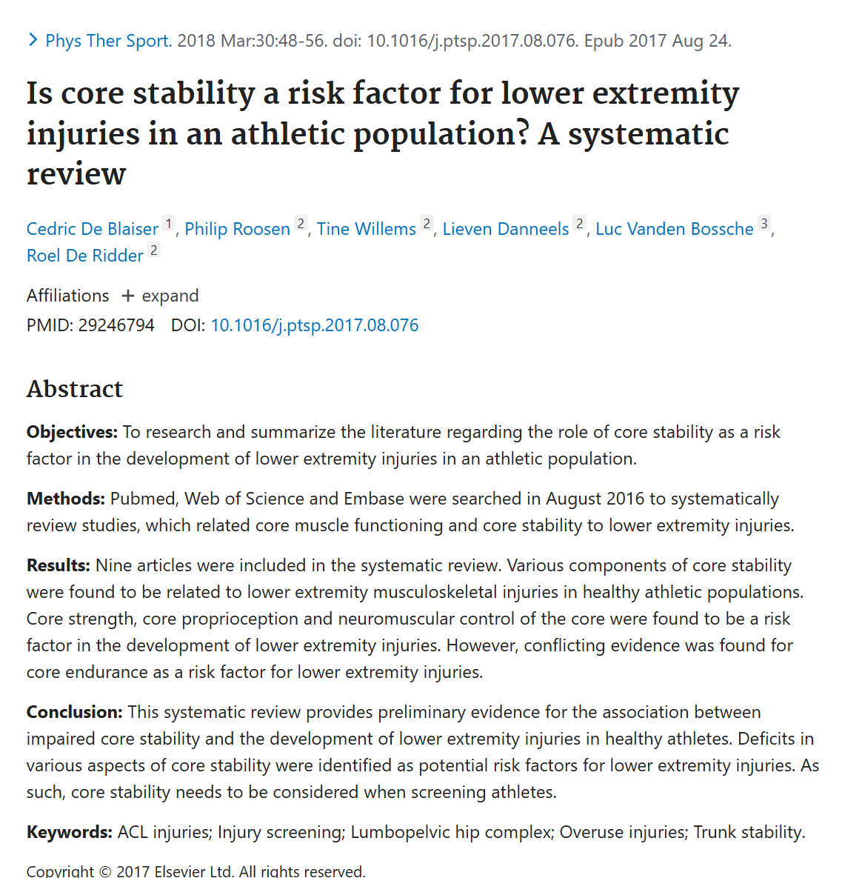
Not Just About Aesthetics: Why weak core is a problem
Yes, https://pubmed.ncbi.nlm.nih.gov/29246794/

Slide 8
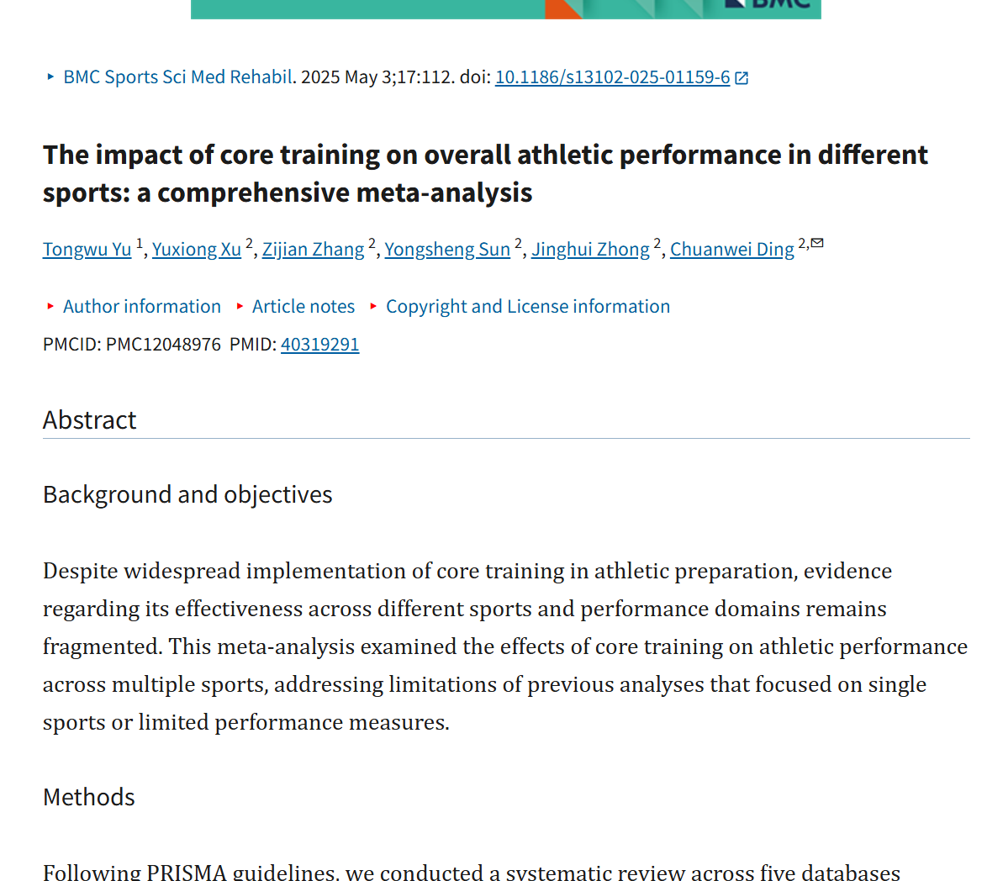
core training improve athletic performance
MA: 29 studies, 950 athletes
General athletic performance
Strong effect for core balance
Actual sport performance is hard to pinpoint bc of so many variables
Notes:
https://pmc.ncbi.nlm.nih.gov/articles/PMC12048976/

Slide 9
Big Problem
Look: Aesthetics (hypertrophy)
Feel: Pain reduction (LBP) (Spine Health)
Perform: Strength for sport/1RM (Function/Movement)
When we don’t realize these are different goals, we don’t modify COFIVRP – so we have miss-matched principles
Imagine training your pecs to: NOBODY Would Do the same training for all 3
Big as possible
Throw baseball
Fix shoulder pain

Slide 10
Example
Crunchies:
Develop RA
LBP specialist might hate it
Bodybuilding coach might love it
Pilates:
Great for core group
Very unlikely to help athletic performance, load is too low
Weightlifter/Only Deadlift:
Great for activation
Poor for deficiencies, weaknesses, or aesthetics (little RA)

Slide 11
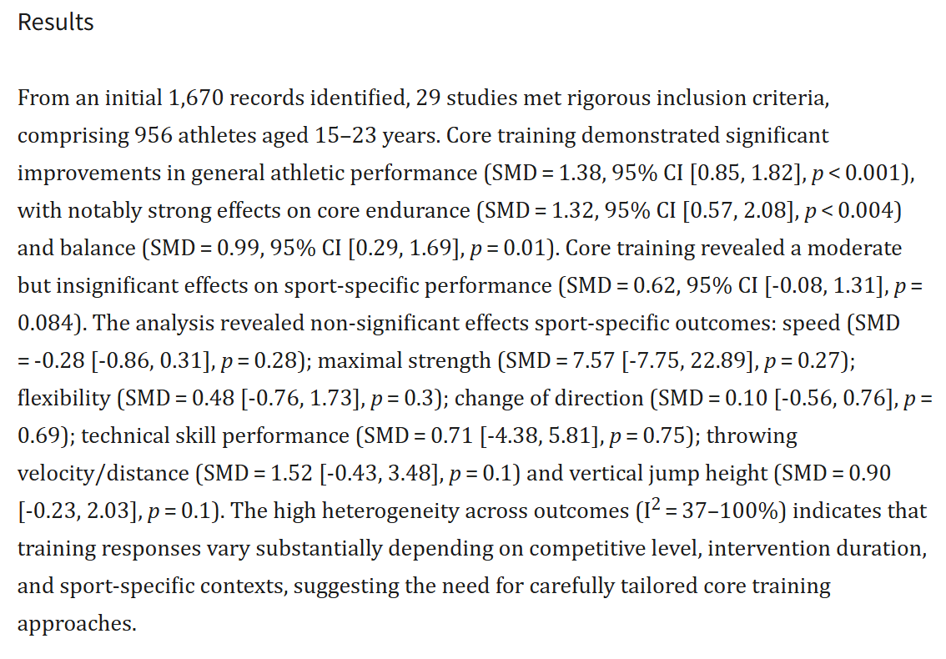
Does core training improve athletic performance
Notes:
https://pmc.ncbi.nlm.nih.gov/articles/PMC12048976/

Slide 12
Physiology/Anatomy

Slide 13
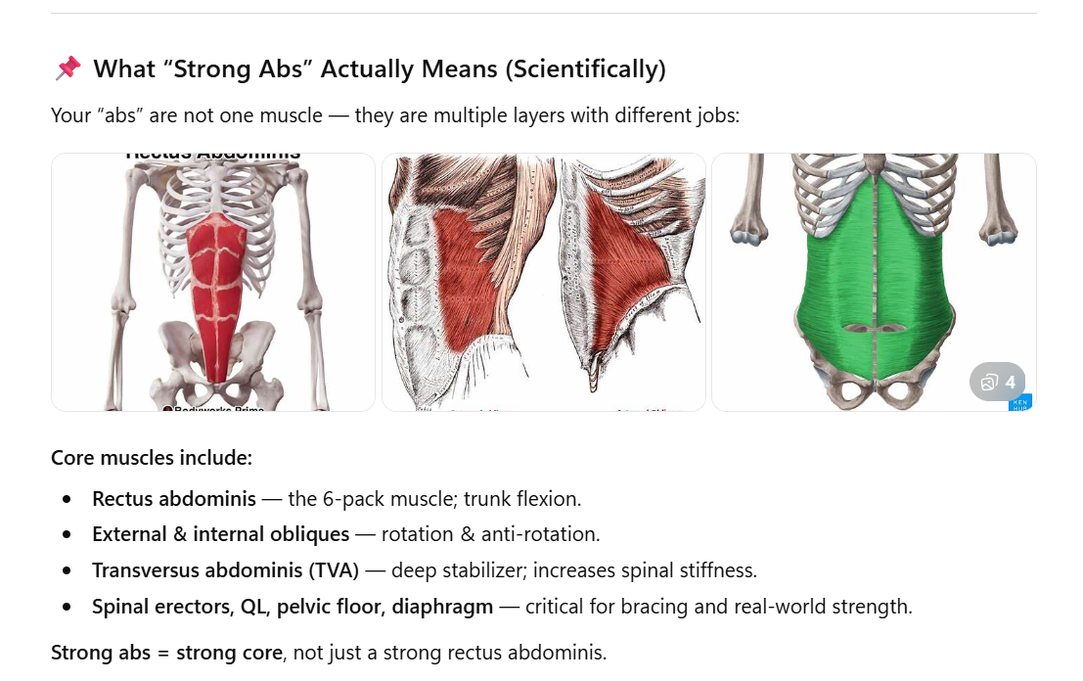
Muscle vs. Movements

Slide 14
Movements vs. Stiffness
Movements:
Flexion
Lateral Flexion
Extension
Rotation
Anti-Movements
Popularized by McGill: Spinal Stability/LBP; NOT 1 or 2

Slide 15
Characteristics
Constantly activated:
At 2-3% during standing
40% during lifting of normal objects
100% during sneezing
Feed-forward stabilization: they fire before (110-150m s) your limbs (1996-1997 Paul Hodges & Carline Richardson)
Houdini Death
Fiber Type is pretty mixed, so it’s not that
Don’t have great data that smaller muscles or ST should be trained differently at all
No data suggesting it needs more or less than your quad

Slide 16
Unique Considerations: Spine Health
High-repetition loading of the lumbar spine during such movements has also been linked to an elevated risk of injury (Solomonow 2012; McGill 2010a).
We want core/spine to move in all types of ways, but we do need to be cautious when putting people to:
End ROM
Heavily loaded
Taken to max or near max effort/volume/fatigue
Example: 1RM deadlift with Jefferson curl position vs. loaded with 15 kg or just body weight
Some ppl are flexion sensitive, some extension, some twisting, some bending, and some non at all
Not about right or wrong, it’s about risk management or ROI

Slide 17
How Do I Know if MY Core Is Strong Enough?

Slide 18
Investigate

Slide 19
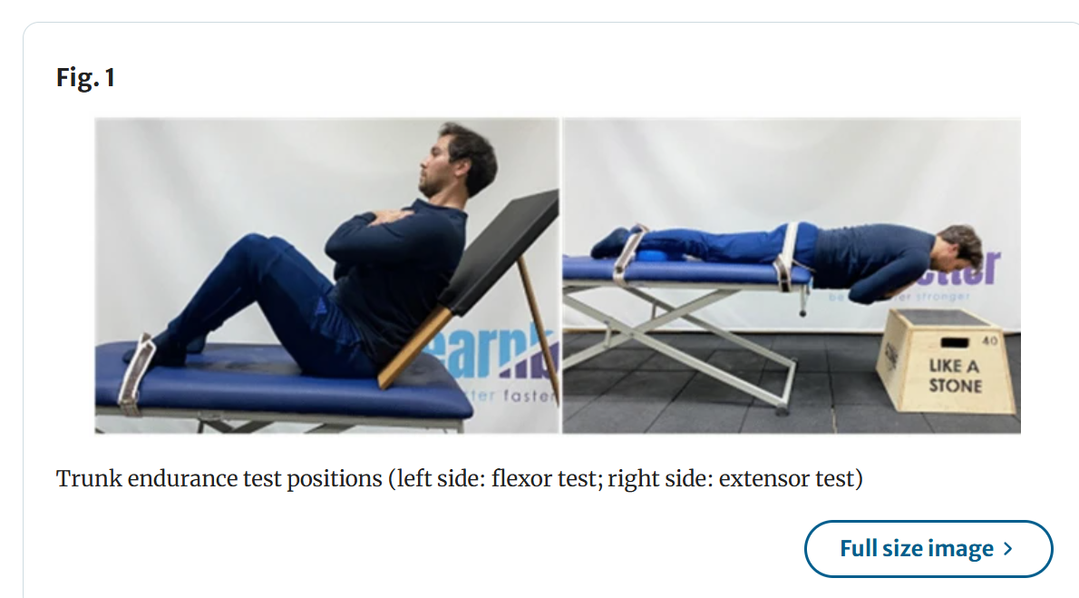
Tests
Flexor Endurance tests
a trunk flexion angle of 45°
The participant sat on the soft test bench and leaned against a support with the upper body at a 45° angle to the bench. The soles of the feet touched the bench and the hips and knees were bent at a 90° angle. A belt was tied around the participant’s feet to support them during the test. The participant’s hands were positioned crossed over the shoulders. The participant was instructed to maintain this position for as long as possible during the test. The duration of the test began when the upper body support was withdrawn 10 cm from the participant. The participant’s upper body angle was checked with a goniometer during the test and the test was terminated if the angle fell below 45° (Fig. 1, left side).
Back Extensors:
The Biering-Sorensen trunk extensor endurance test was used to measure the endurance performance of the participants’ back extensor muscles (Biering-Sørensen 1984)

Slide 20
How Do I Know if MY Core Is Strong Enough?
Look: Optima Muscle
Feel: Sahrmann 5 level core stability test
Raise one leg to 90/90, then next leg
L5: Double leg up double down
Perform:
EMG
Proteus Machine
Probably some sort of Muscular Endurance Test

Slide 21
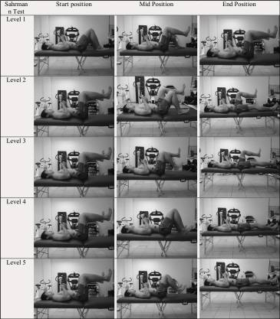

Slide 22
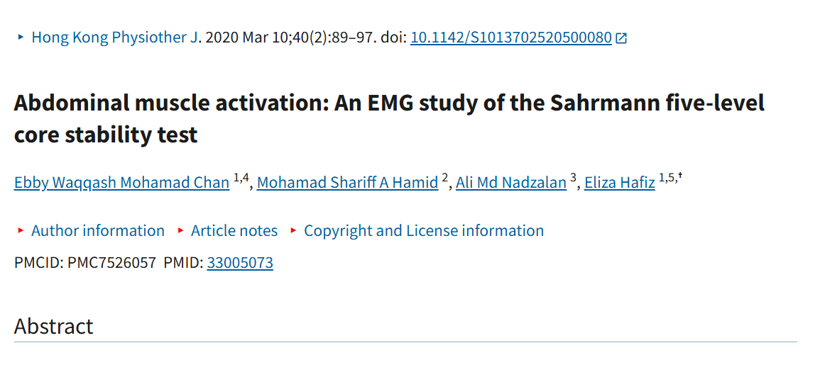

Slide 23
Outline: Look, Feel, Perform
COFIVRP

Slide 24
Intervene

Slide 25
Which Exercises “Work Core” More
Core (plank, back extensions, side bends) vs. “Integrated” (deadlift, OH press, lunges) etc.
Isolated vs. Functional, Dynamic
Generally: Free-weights & Suspension > isolated core, especially after reasonable training experience

Slide 26
Load/Contraction Intensity
Key here is EFFORT: SIZE Principle
Wall squats vs. leg press (fatigue is not the same as force production)
HARD to load up weights on sit-ups, side bends, and russain twists without hurting back
Much Easier to put hundreds of pounds on sled or carry, force core to stabilize vs. move

Slide 27
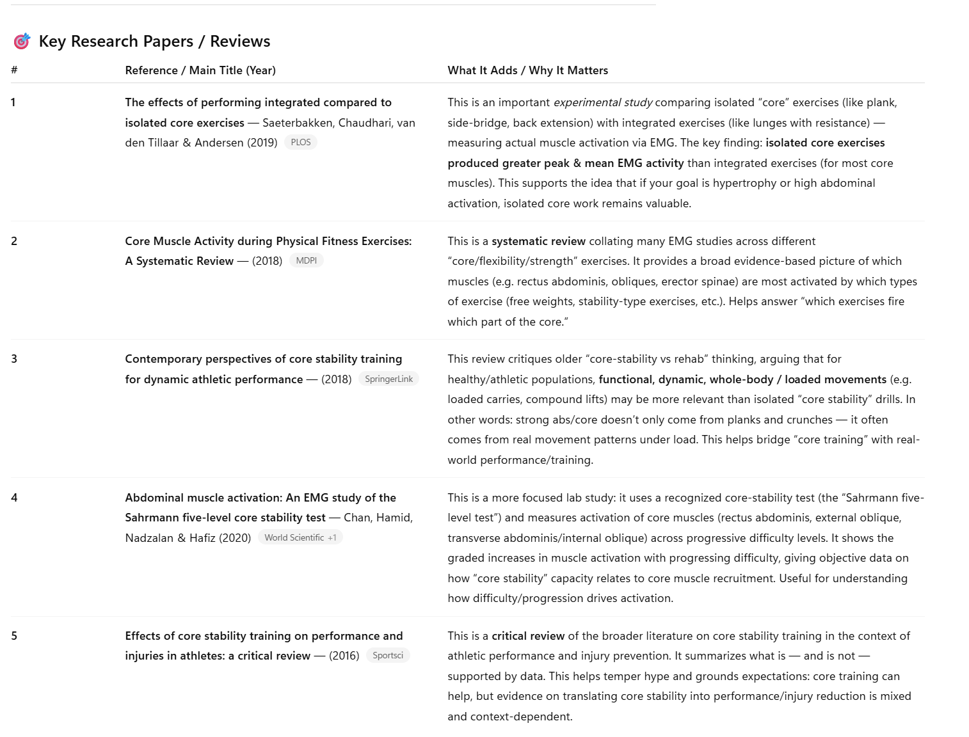

Slide 28
Exercise Examples: Movement
Flexion
Crunch or Sit-up, Jack knife,
Anti: Posterior Pallof hold, supine plank, suspended supine plank
Lateral Flexion
Side plank hip dips, swiss ball side crunch, oblique v-up,
Anti: Side plank band row, lateral plank, suspended lateral plank
Extension
Supermans, back extension, Straight bridge, swill ball bridge, swiss ball reverse extension
Anterior Pallof Hold, prone plank, suspended prone plank
Rotation
Russian Twists, windshield wipers
Anti: Supine lying pallof hold, pallof hold,

Slide 29
Exercise Examples: Muscle
RA
Weighted cable, reverse crunch/leg raise (how to do this), ab wheel,
Obliques
Pallof press, woodchop, suitecase carry, side plank
TA
Dead bug, stir the pot, etc.
Rotation
Russian Twists, windshield wipers
Anti: Supine lying pallof hold, pallof hold,

Slide 30
Look/Hypertrophy
Nutrition
Rest Intervals: Any
Frequency: 2-4x
Volume: 6-20 working sets
Intensity: 2 RIR
Progression: SOME!
Choice: More complicated
VERY Little Research (all on strength/EMG)

Slide 31
Study | Muscles | Intervention | Duration | Measurement | Magnitude of Growth
HIFEM – Kinney 2019 | RA | HIFEM abdominal stimulation | 2 mo | MRI | ~15% ↑ thickness
HIFEM – Kent & Jacob 2019 | RA | 8‑session HIFEM | 1 mo | CT | ~15% ↑ thickness
HIFEM – Liu 2024 | RA | 8‑session HIFEM | 2–3 mo | MRI | 0.6–21% ↑ volume
NMES – Minerva Medica 2020 | RA, IO/EO | 8‑week NMES | 8 wk | MRI | RA ~22–25% ↑ CSA, LAW ~9–10% ↑
NMES – Hwang 2020 | RA, IO/EO | EMS vs. EMS+voluntary | 8 wk | MRI | RA ~20% ↑ CSA
NMES – Inoue 2023 | RA, IO/EO | NMES + detraining | 8 wk | MRI | RA ~21–25% ↑ CSA; partially retained
Exercise – Hollowing vs Bracing 2014 | RA, TrA, IO, EO | 6‑wk core training | 6 wk | CT | TrA ~15–20% ↑ CSA; IO/EO ↑ modest; RA ↑ ~4–5%
Pilates Core Stabilization 2023 | TrA, IO, EO | 6‑week Pilates | 6 wk | Ultrasound | TrA ↑ 10–20%; IO ↑ 5–10%
Normal‑Weight Obese Core 2023 | TrA, IO, EO | 4‑week core program | 4 wk | Ultrasound | Small ↑ across all muscles (~5–10%)
Foam Roller RCT 2023 | TrA | 3‑month foam-roller core | 12 wk | Ultrasound | TrA ↑ ~10%
Trunk Strengthening – JOSPT 2008 | TrA, IO, EO | Core stabilization | 8 wk | Ultrasound | Deep abdominals ↑ (TrA ~10–15%)

Slide 32
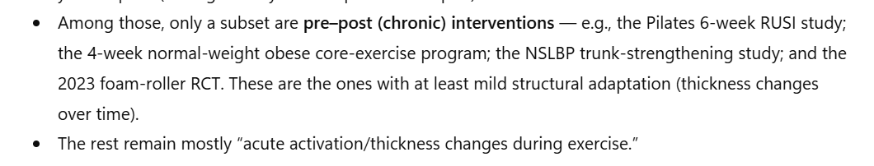

Slide 33
Choice: By Muscle or Movement
50% Core, 50% Big
Big are a) more dynamic, b) much better EMG/load, c) keeps volume down
Movement and ANTI (you can do more and be hurt less)

Slide 34
Physique Considerations
Posture: Anterior tilt will make stomach ‘less flat’
No diaphragm control = flare

Slide 35
Strength
Rest Intervals: Any
Frequency: 3-5x
Volume: 6-15 working sets
Intensity: 1 RIR
Progression: SOME!
Choice: More complicated
Lots of Research

Slide 36
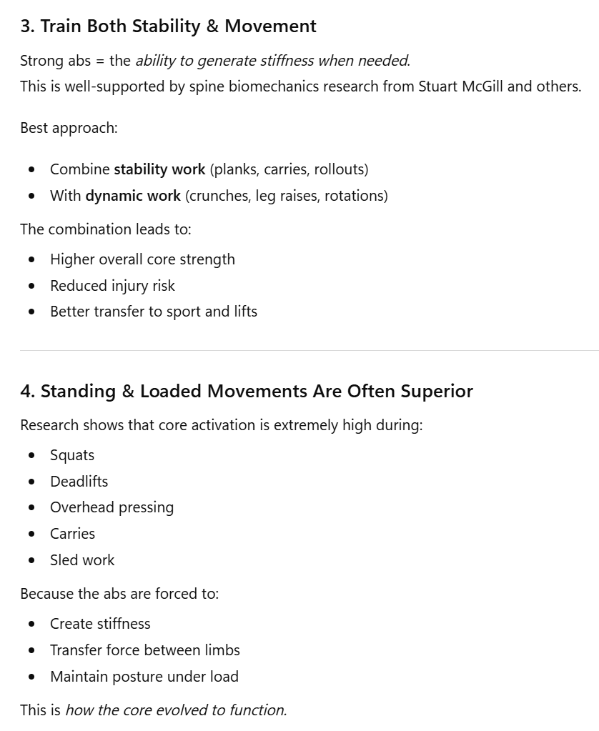
Choice: By Muscle or Movement
75% Big, 25% Actual “Core” Exercises
These are awesome, but research clearly shows they are not always enough. Isolation work is necessary in some scenarios

Slide 37
Spine Health
Rest Intervals: Any
Frequency: 3-6x
Volume: 10-30 working sets
Intensity: 3 RIR
Progression: SOME!
Choice: More complicated
Most Research By Far
80/20%; Low load just not enough

Slide 38
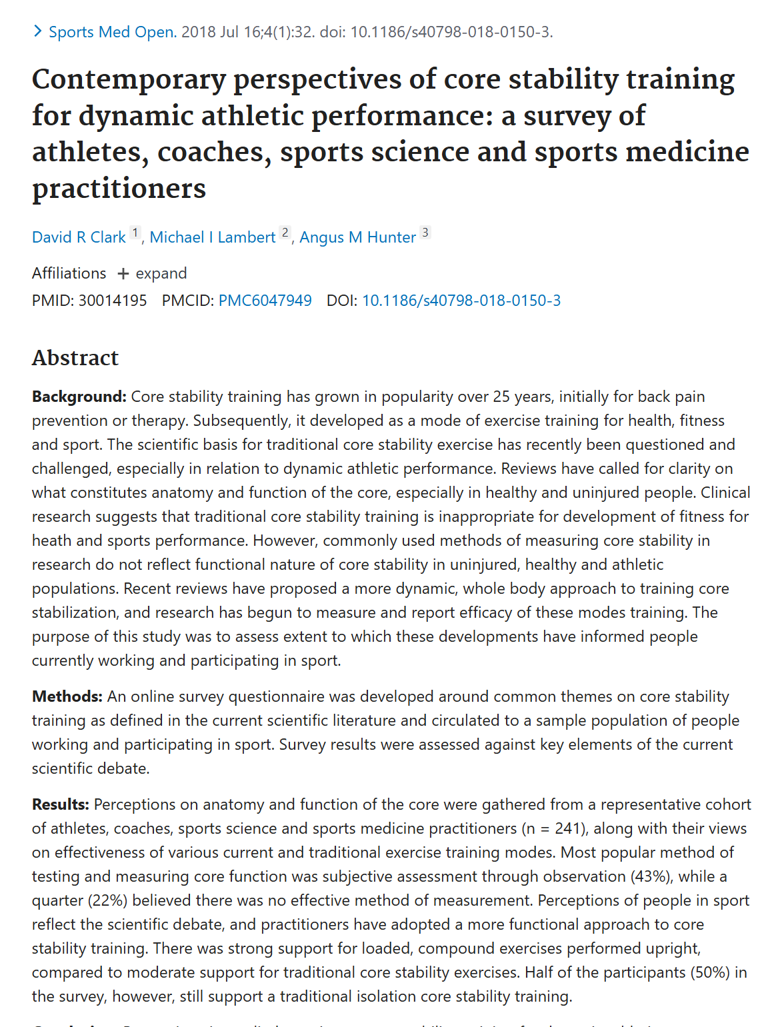
Big vs. Small Movements
Low load isolation only exercises are just not that effective. https://pubmed.ncbi.nlm.nih.gov/30014195/
Should push for dynamic & loaded patterns

Slide 39
Choice: By Muscle or Movement
Day 1, 3, & 6: 6-12 rep range, 2-3 working sets each
Anti Extension: Stability
Pick 1:
Ab-wheel, Dead bugs
Why: High activation of RA and TVA with low spine load
Anti Rotation & Anti-Later Flexion: Dynamic Stability
Pick 1
Side Planks, Suitcase Carry
Why: Obliques
Flexion (Ok since we have variety and managed volume): Movement
Pick 1
Hanging leg raise, Cable crunch
Why Good for RA when SPINE is Controlled!
Day 2, 4, 5 : 15-30 rep range, 2-3 working sets each

Slide 40
Programming
1 flex
1 anti
1 rotation

Slide 41
Progression; 5 steps
Progression: JUST LIKE EVERYTHING ELSE!
Load, volume, ROM, etc
Isometric Control & Fatigue Resistance
Anti/Eccentric w/ Fatigue resistance
Anti/Ecc w/ Load
Concentric w/ Fatigue
Concentric w/ Load

Slide 42
Progression; 5 steps - Example
Isometric Control & Fatigue Resistance
Plank
Anti/Eccentric w/ Fatigue resistance
Reverse Crunch/Deadbug for 30-50 reps
Anti/Ecc w/ Load
Decline or weighted crunch; 5-8 reps
Concentric w/ Fatigue
Cable crunch w/ 20-30 reps
Concentric w/ Load
Cable crunch heavy for 5-8 reps

Slide 43
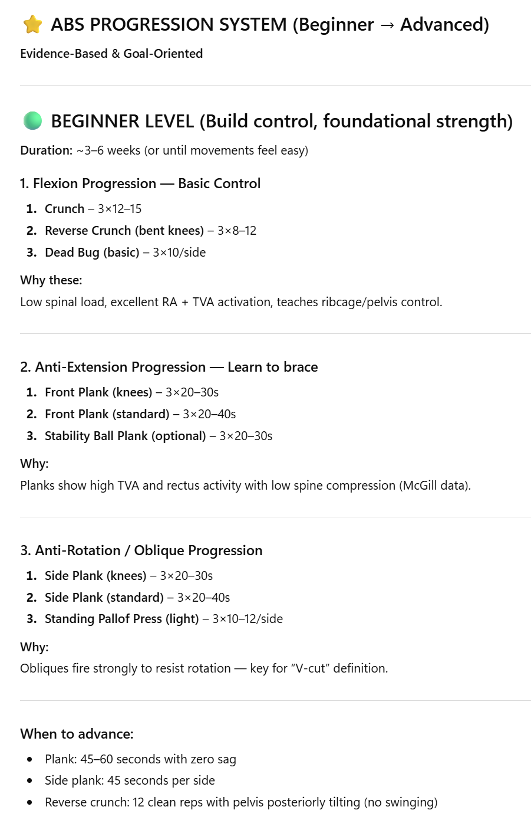
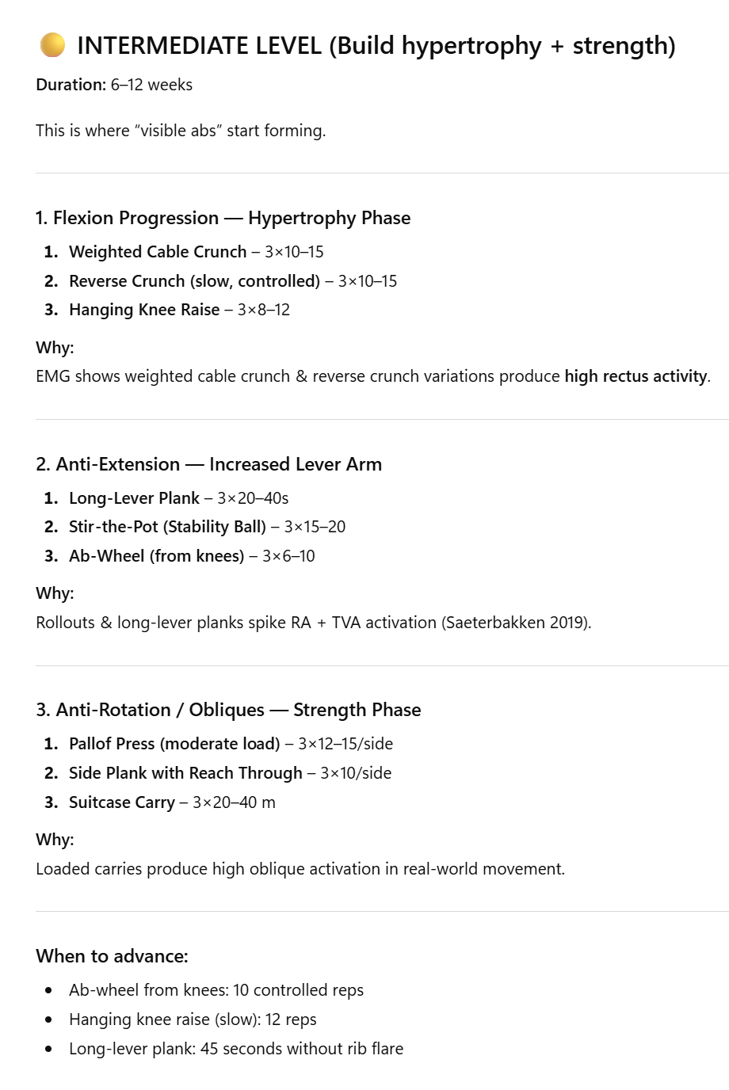
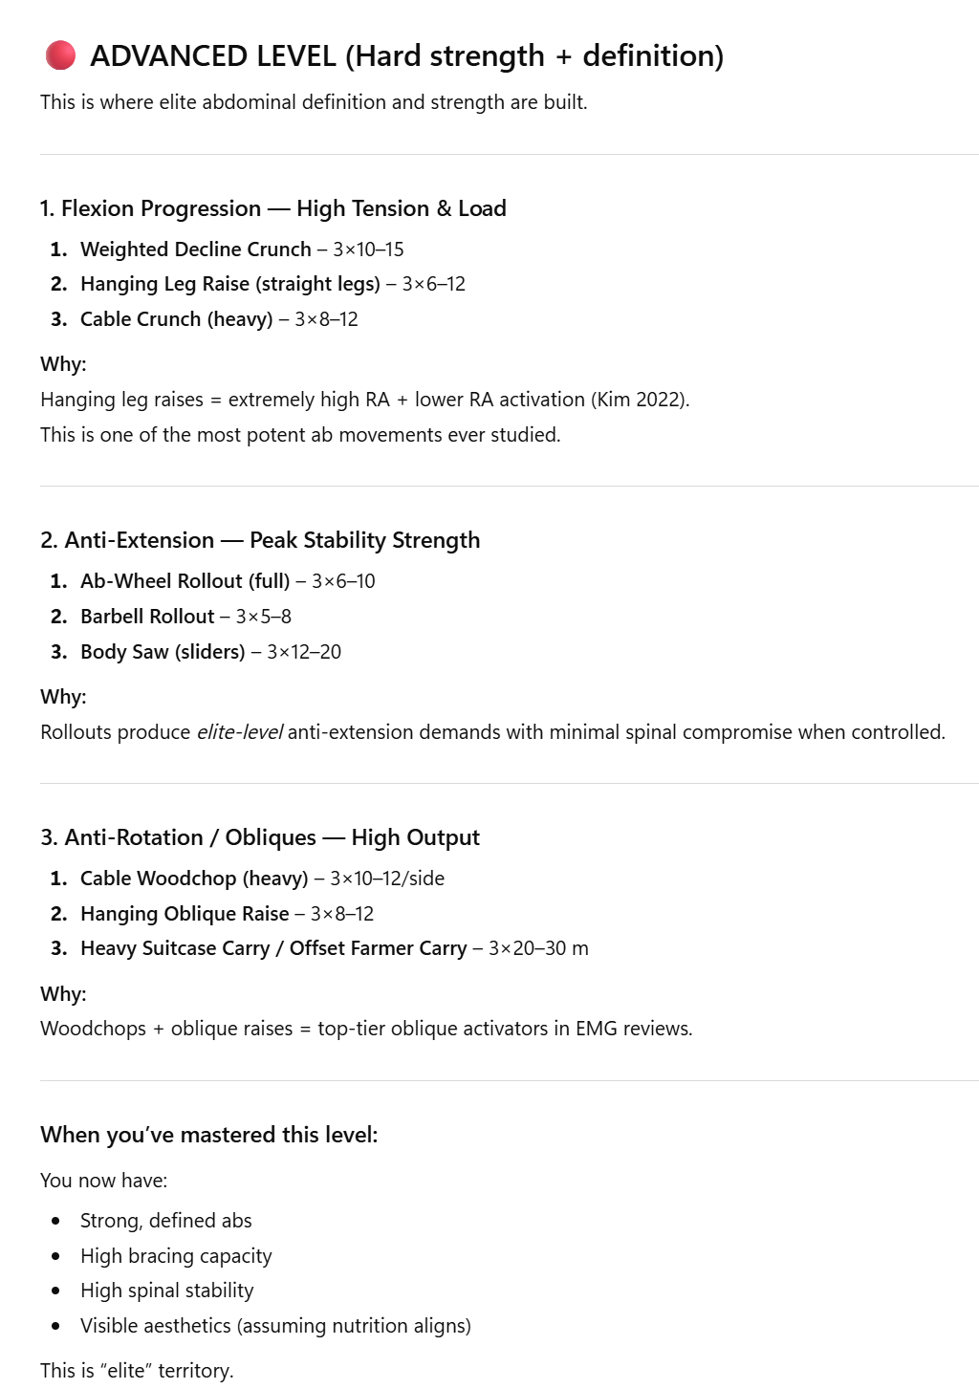

Slide 44
Order :
Rib mobilization as a warm-up
Pre-fatigue concerns
Other order stuff doesn’t matter much
Diaphragm & intercostal control for better endurance performance

Slide 45
6 Month $1M Challenge: 1. Weight Belt or No? 2. Bench Press vs. Crunchies 3. Machines vs. Unstable/DB’s? 3. Every day or 2-3x per week?

Slide 46
Notes

Slide 47
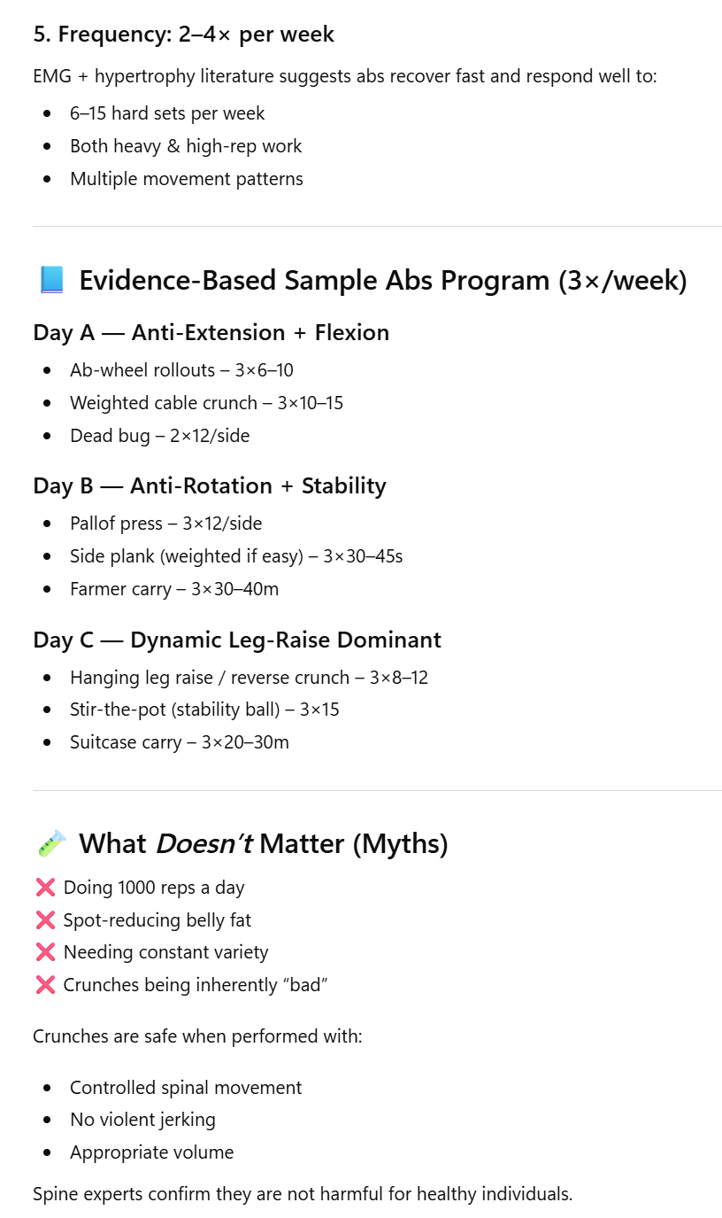
Common Myths

Slide 48
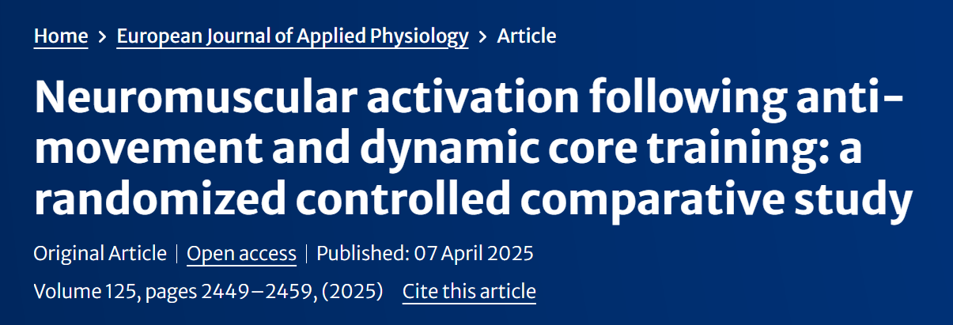
https://link.springer.com/article/10.1007/s00421-025-05768-4?utm_source=springer_etoc&utm_medium=email&utm_campaign=CONR_00421_AWA1_GL_DTEC_054CI_TOC-250925&utm_content=etoc_springer_20250925

Slide 49
Traditional Core Training
flexion, extension, and rotation
long recognized for its effectiveness in enhancing strength and stabilization (Schilling et al. 2013).

Slide 50
Consequences
High-repetition loading of the lumbar spine during such movements has also been linked to an elevated risk of injury (Solomonow 2012; McGill 2010a).
Some don’t tolerate sit-ups
See McGill on Huberman

Slide 51
Tests
EMG
Flexor & Extensor Endurance tests
Rectus Abdominus & Oblique Test
a trunk flexion angle of 45°
The participant sat on the soft test bench and leaned against a support with the upper body at a 45° angle to the bench. The soles of the feet touched the bench and the hips and knees were bent at a 90° angle. A belt was tied around the participant’s feet to support them during the test. The participant’s hands were positioned crossed over the shoulders. The participant was instructed to maintain this position for as long as possible during the test. The duration of the test began when the upper body support was withdrawn 10 cm from the participant. The participant’s upper body angle was checked with a goniometer during the test and the test was terminated if the angle fell below 45° (Fig. 1, left side).
Back Extensors:
The Biering-Sorensen trunk extensor endurance test was used to measure the endurance performance of the participants’ back extensor muscles (Biering-Sørensen 1984)

Slide 52
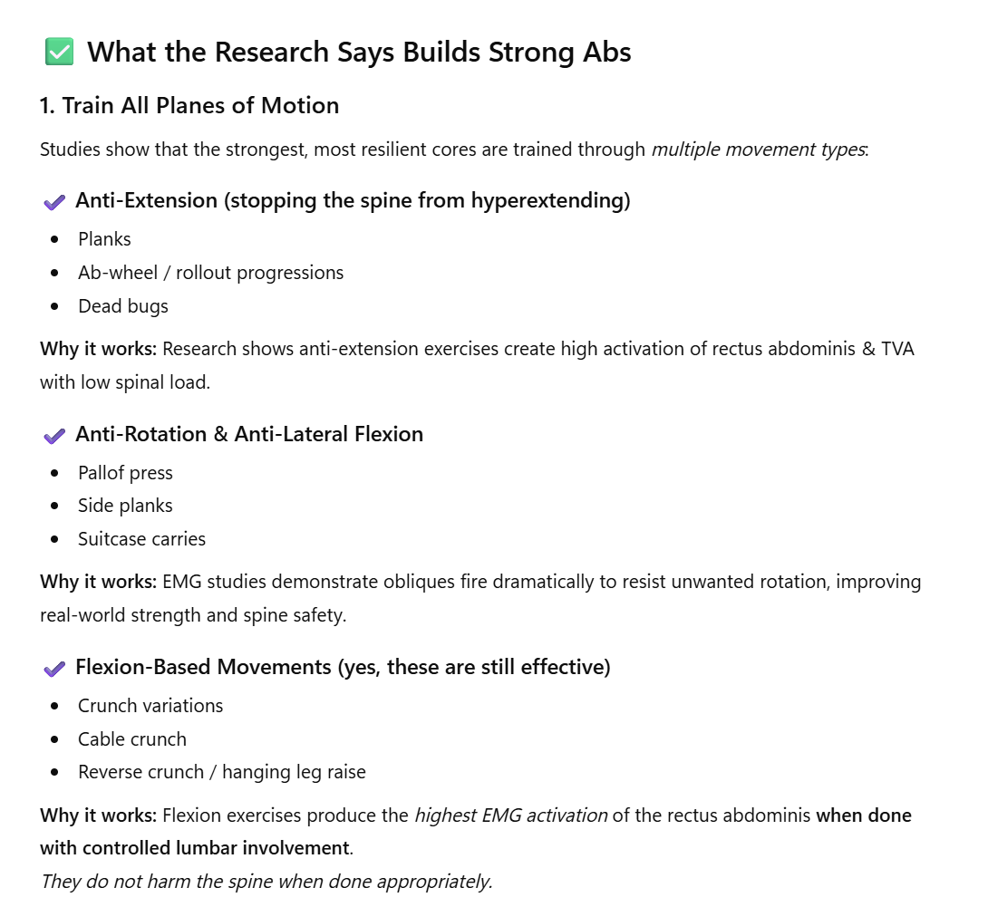

Slide 53
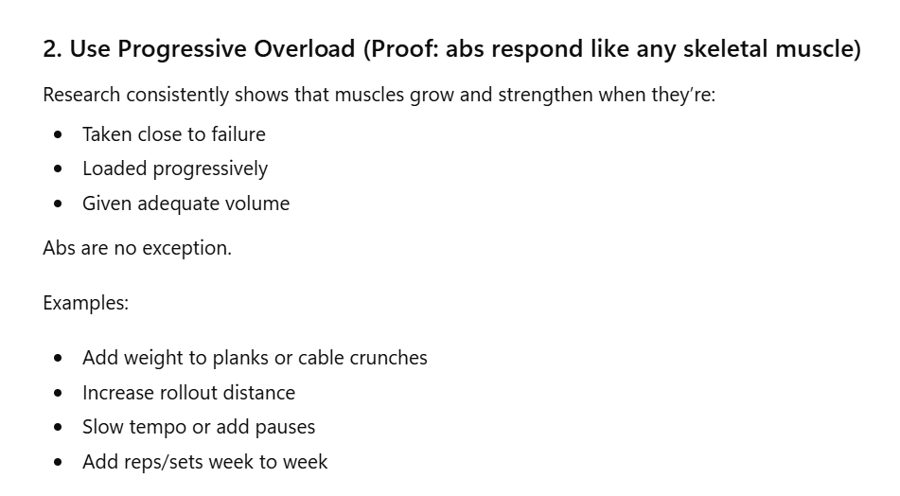

Slide 57
Big vs. Small Movements
Athlete/Sport Performance:
Big might be enough
These are awesome, but research clearly shows they are not always enough. Isolation work is necessary in some scenarios
Movement patterns, back/hip pain, function:
Choose mostly core-specific (small) patterns
Specifically wanting bigger more visible abs:
Big & Small
Longevity: probably pick option #3
Low load isolation only exercises are just not that effective. https://pubmed.ncbi.nlm.nih.gov/30014195/
Should push for dynamic & loaded patterns

Slide 58
Why weak core is a problem
Yes, https://pubmed.ncbi.nlm.nih.gov/29246794/

Slide 59
Does core training improve athletic performance
https://pmc.ncbi.nlm.nih.gov/articles/PMC12048976/

Slide 60
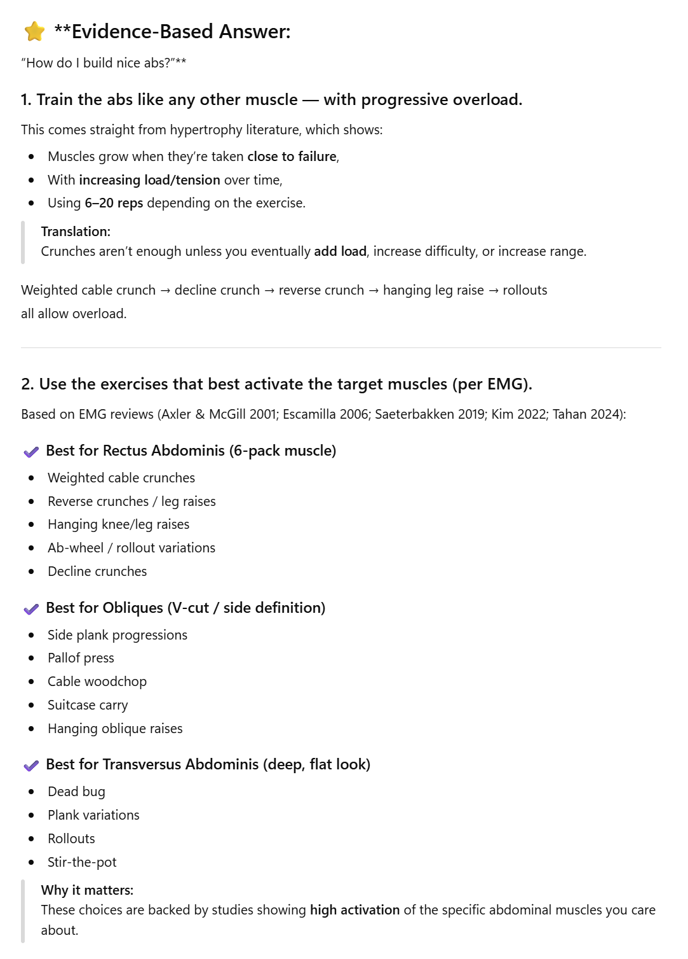
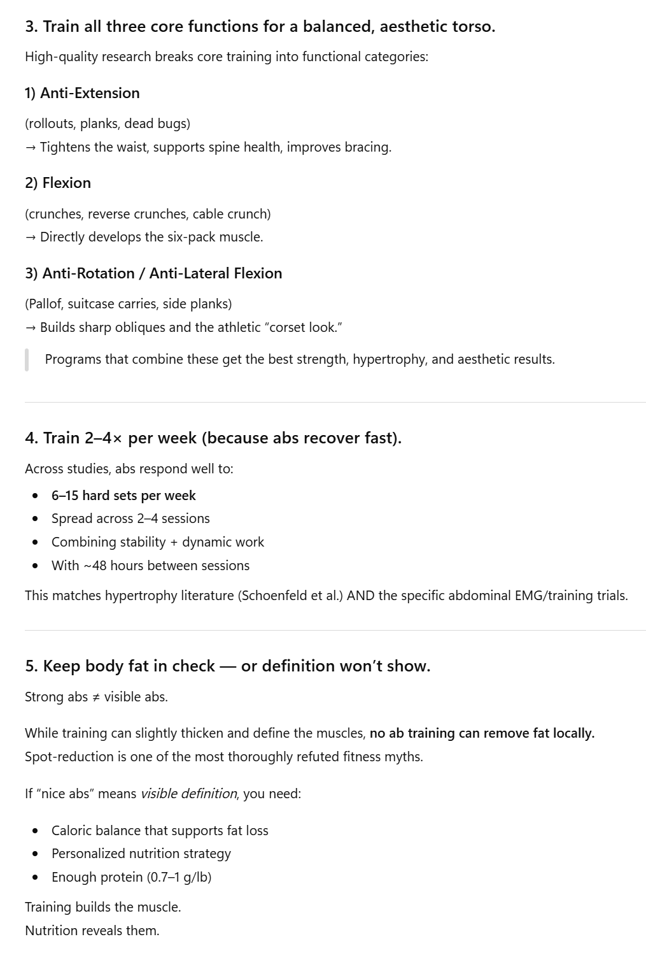

Slide 61
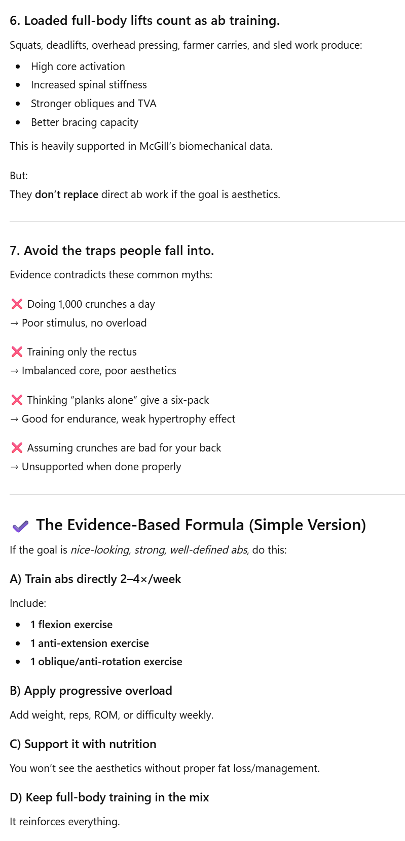
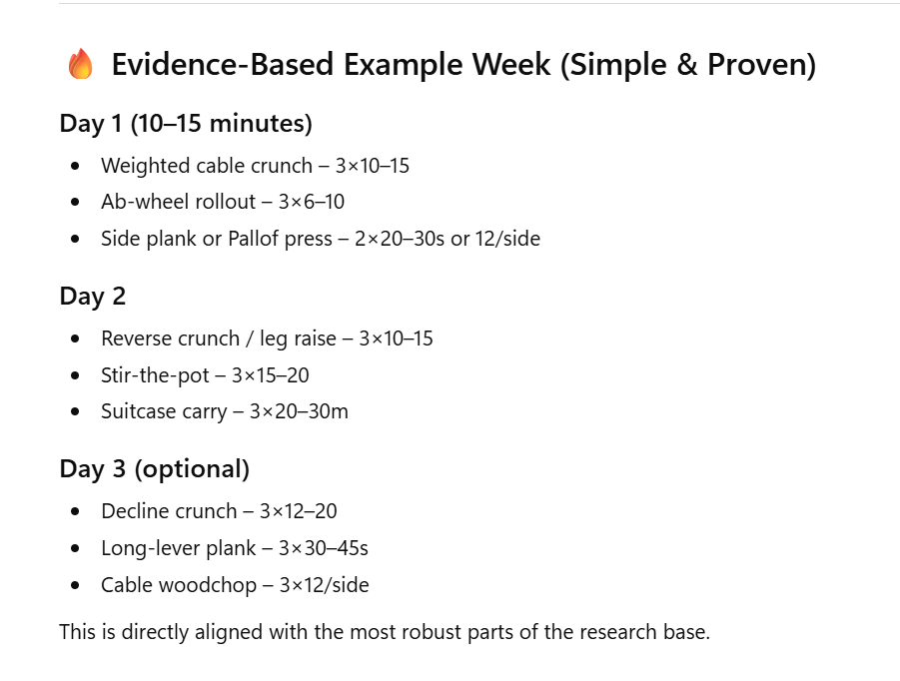

Slide 63
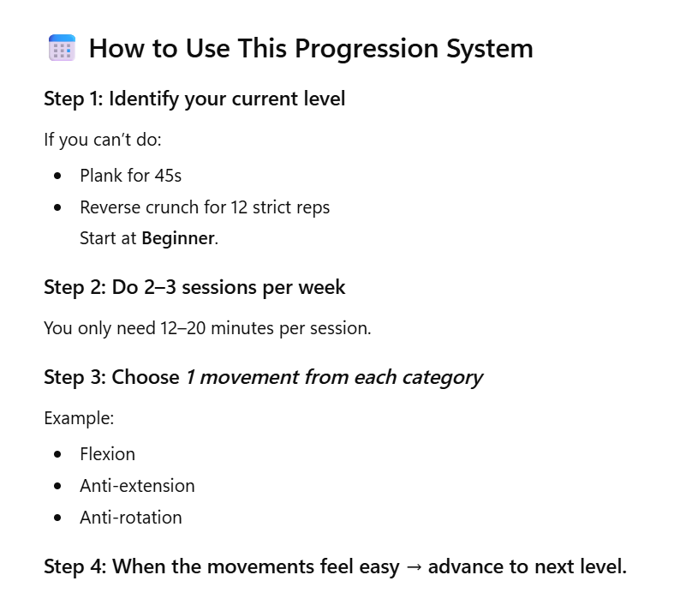

Slide 65
Core/Abdominal Muscle Hypertrophy Table
Study | Muscles | Intervention | Duration | Measurement | Magnitude of Growth
HIFEM – Kinney 2019 | RA | HIFEM abdominal stimulation | 2 mo | MRI | ~15% ↑ thickness
HIFEM – Kent & Jacob 2019 | RA | 8‑session HIFEM | 1 mo | CT | ~15% ↑ thickness
HIFEM – Liu 2024 | RA | 8‑session HIFEM | 2–3 mo | MRI | 0.6–21% ↑ volume
NMES – Minerva Medica 2020 | RA, IO/EO | 8‑week NMES | 8 wk | MRI | RA ~22–25% ↑ CSA, LAW ~9–10% ↑
NMES – Hwang 2020 | RA, IO/EO | EMS vs. EMS+voluntary | 8 wk | MRI | RA ~20% ↑ CSA
NMES – Inoue 2023 | RA, IO/EO | NMES + detraining | 8 wk | MRI | RA ~21–25% ↑ CSA; partially retained
Exercise – Hollowing vs Bracing 2014 | RA, TrA, IO, EO | 6‑wk core training | 6 wk | CT | TrA ~15–20% ↑ CSA; IO/EO ↑ modest; RA ↑ ~4–5%
Pilates Core Stabilization 2023 | TrA, IO, EO | 6‑week Pilates | 6 wk | Ultrasound | TrA ↑ 10–20%; IO ↑ 5–10%
Normal‑Weight Obese Core 2023 | TrA, IO, EO | 4‑week core program | 4 wk | Ultrasound | Small ↑ across all muscles (~5–10%)
Foam Roller RCT 2023 | TrA | 3‑month foam-roller core | 12 wk | Ultrasound | TrA ↑ ~10%
Trunk Strengthening – JOSPT 2008 | TrA, IO, EO | Core stabilization | 8 wk | Ultrasound | Deep abdominals ↑ (TrA ~10–15%)

